Slide 1
Enabling User Space Secure Hardware
Michael Coughlin
Notes:
Hello and thank you for coming. My name is Michael Coughlin and I will be presenting my dissertation, entitled enabling user space secure hardware.

Slide 2

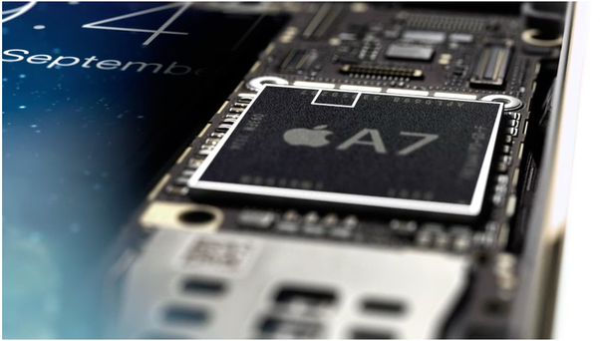
What is secure hardware?
Silicon chips that protect against other parts of the system
Useful to defend against untrusted software
Can defend against some kinds of physical threats
Notes:
To put my work into context, I want to start off by overviewing what I mean by secure hardware.
I define secure hardware as any silicon chip in a system that is designed to defend against any other component of the system.
These systems are most useful in defending against untrusted software, but can be extended to defend against some kinds of physical threats.

Slide 3

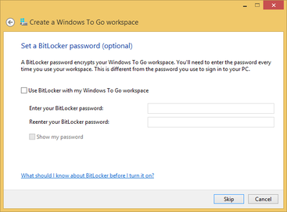
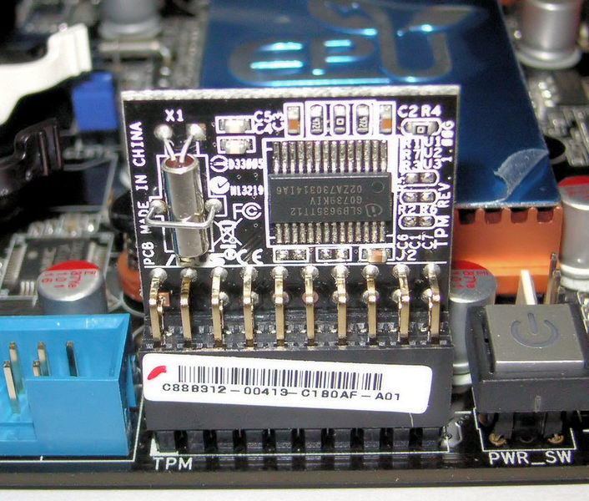
Trusted Platform Modules
Secure coprocessor that provides cryptographic functions
Most popularly used for disk encryption
Notes:
Trusted Platform Modules are one of the most widely used secure hardware systems. They are a secure coprocessor that runs trusted code that exposes a standardized API to a system. They offer many different cryptographic operations that are executed by the isolated code.
Their most common application these days is for full disk encryption, such as in Microsoft bitlocker.
“Shielded” cryptography using protected, securely-generated keys
Remote attestation
Sealing and binding of data
Sealing & binding: also can require stateful interaction with the TPM to decrypt

Slide 4
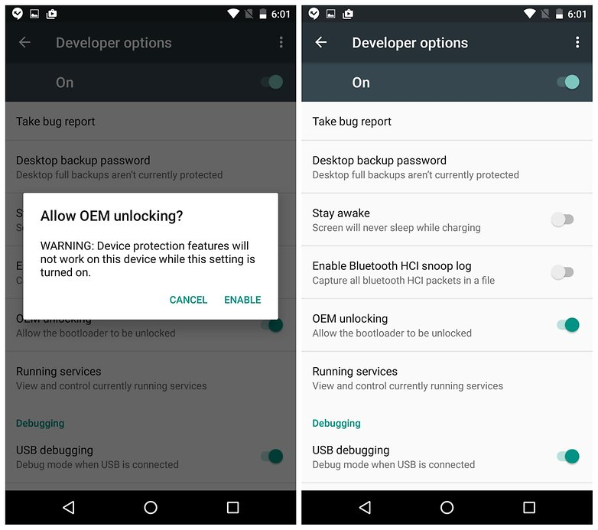
Secure Boot
A.K.A. Trusted Boot, Verified Boot
Used to ensure that only trusted operating systems boot
Checks a signature of any booted software
Notes:
Secure boot systems, sometimes known as trusted boot or verified boot, are also very common.
They are used to ensure that only a trusted operating system can boot in a system by checking the signature of the OS before letting it boot.
In UEFI, checks the bootloader against a set of pre-shared keys
In Google or Apple, verifies a signature against the manufacturer’s public key

Slide 5
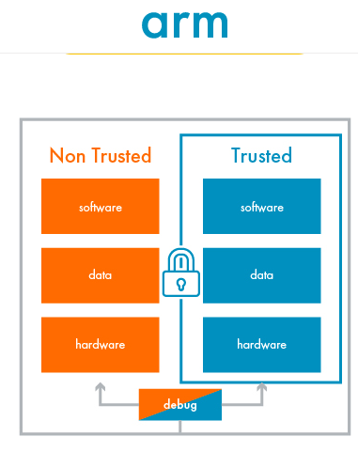
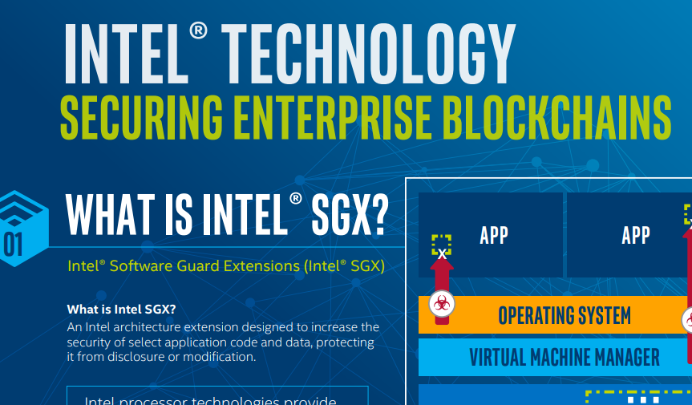
Trusted Execution Environments
ARM TrustZone
Intel SGX, TXT
App 1
App 2
Isolated App
Operating System
CPU
TEE
Isolated Memory
Memory
Notes:
Trusted execution environments, such as arm trustzone or intel’s software guard extensions, are used to isolate software, similar to a secure coprocessor, but for arbitrary code. TrustZone and SGX do this but creating an isolated environment in a CPU that prevents the execution of software from being observed and provides some sort of isolated memory- trustzone uses an amount of on-chip memory and SGX uses memory encryption.
Animation:
TEEs often reuse existing CPU hardware
They exist alongside normal software, such as untrusted OS’s and code
The TEE is an isolated environment in the CPU with some type of isolated memory
An isolated app can then be loaded and execute independently from the untrusted code
TEES isolate software from an untrusted OS
Generally reuse CPU hardware with the CPU mediating communication between trusted and untrusted code

Slide 6
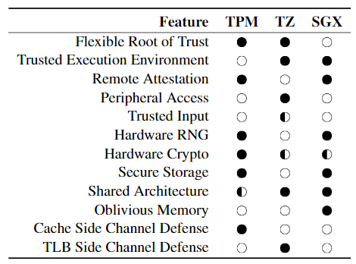
Problem: Only Manufacturers Make Decisions
Manufacturers decide what features to include
Manufacturers decide when and if patches are available
Notes:
The problem with secure hardware is that all of the decisions on what features to include are made by manufacturers, not developers. This would not be a problem if all the features you need for an application were available in all systems, but this is not true. Features available in some systems are not available in others, and there are very few competing systems in general.
Manufacturers are capable of making some changes, but only they can make them. Developers do not have any way to make these changes.

Slide 7
What if developers could make these decisions?
Notes:
We ask the question: what if developers could make these decisions?

Slide 8
Introducing User Space Secure Hardware
Let developers define their own secure hardware features
User Space
Application
define
Kernel Space
Operating System
Processor
Secure Hardware
Notes:
Here, we introduce our solution: user space secure hardware. The goal of this system is to let developers define their own secure software alongside their software. This allows for software to load secure hardware dynamically without requiring each application to fundamentally integrated into the system, such as being built into the operating system.
- We note that secure hardware does not necessarily need to be implemented in silicon

Slide 9
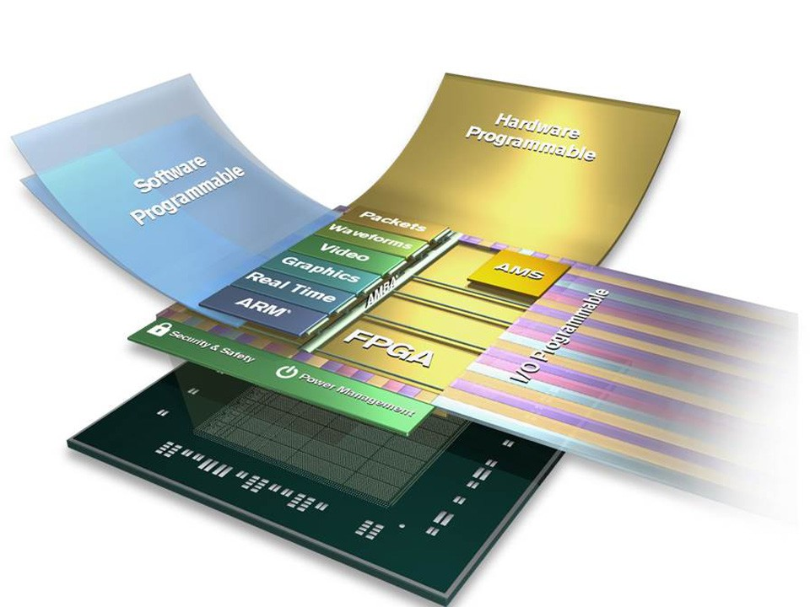
How to Realize the Vision - FPGAs
Leverage reprogrammability of FPGAs to provide reconfigurable secure hardware
Expose reprogrammability to applications
Notes:
We realize this vision using FPGAs. Since FPGAs are reconfigurable hardware, we see this as an ideal method to provide reconfigurable secure hardware.
We then take that reconfigurability and expose it to applications.

Slide 10
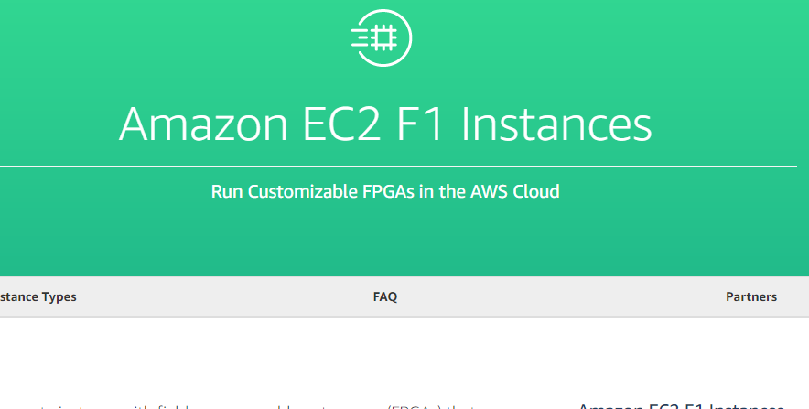
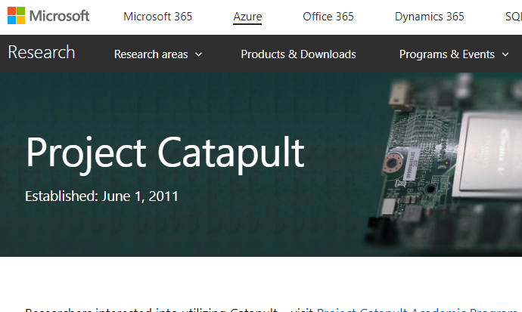
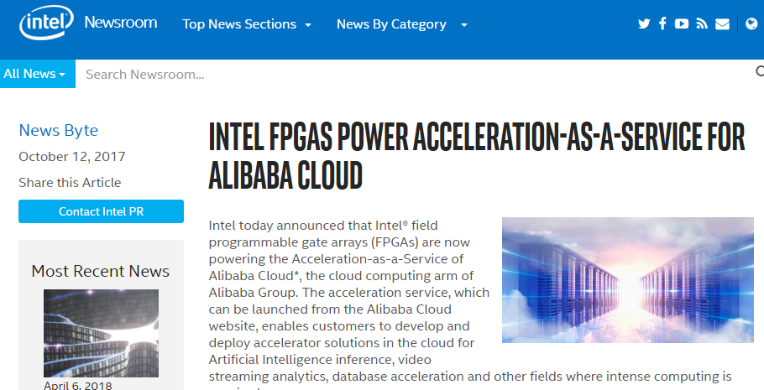
FPGAs Everywhere
Devices exist that combine FPGAs with CPUs
Takeaway: FPGAs are becoming ubiquitous
Notes:
We note that FPGAs are starting to pop up everywhere in computing systems, especially in data centers and embedded systems.
The takeaway from this is that FPGAs are starting to become ubiquitous.
Are FPGAs the only way to do this? No (as Eric W always says). There are other ways, but we chose to use an FPGA. FPGAs have nice properties for applications, as shown for Cloud RTR
Since FPGAs are already going to be everywhere, we can use them.

Slide 11
FPGA Challenges: Sharing
App 4
App 5
Single Application
App 1
App 2
App 3
FPGA
FPGA
What FPGAs are Today
What we want FPGAs to be
Notes:
However, FPGAs present several challenges if we want to use them this way. The first is the problem of sharing an FPGA. Today, applications are essentially designed to support a single application. What we want them to do is support many applications at once.
Today, FPGAs are really only designed to run a single application
What we want is to be able to share the FPGA between different applications and load them independently

Slide 12
Solution: Cloud RTR
Introduces a new, practical cloud compilation mechanism to overcome FPGA sharing limitations
Notes:
(Be here by 7 minutes)
We have a solution to this that we call Cloud RTR, which introduces a new and practical cloud compilation systems that overcomes FPGA’s lack of sharing. Cloud RTR lets us provide the user space portion of user space secure hardware.

Slide 13
FPGA Challenges: Reprogrammability
Immutable nature of silicon is a basis for the guarantees of secure hardware
FPGAs are reprogrammable
=> seems to compromise security properties
Notes:
The other challenge to using FPGAs for user space secure hardware is the fact that they are reprogrammable.
The fact that you can change the functionality of the hardware seems to negate the benefits of using a hardware implementation, as it removes the properties that hardware provides.

Slide 14
Existing Threat Model
Secure Hardware
Secure Hardware
System
Notes:
The existing threat model for secure hardware is that it defends against other components in the system.
Secure hardware defends against other components in the system
Provides a trusted execution in the midst of untrusted execution, e.g. a “guaranteed” function in the midst of a number of unknown functions beyond its control
The secure hardware always performs its functionality, despite the rest of the system colluding against it

Slide 15
Existing Threat Model
Code
Secure Hardware
TrustZone
Peripherals
System
Notes:
For example, TrustZone defends against untrusted code, such as the operating system, by isolating computation of trusted software, and against untrusted peripherals, like memory and controllers, by setting access control policies.

Slide 16
Existing Threat Model
Code
Secure Hardware
SGX
Memory
System
Notes:
SGX provides similar protections against untrusted software, but specifically protects against untrusted memory access using memory encryption.

Slide 17
Existing Threat Model
Storage
Secure Hardware
TPM
CPU
System
Notes:
TPMs provide protection against untrusted storage by including their own secure storage of keys and against an untrusted CPU using a separate coprocessor.

Slide 18
Existing Threat Model
Storage
Secure Hardware
Secure Boot
System
Notes:
Secure boot protects against untrusted storage by requiring a signature over an operating system before it can be loaded.

Slide 19
Existing Threat Model
Secure hardware defends against other system components
Can be extended to some physical adversaries
Adversaries that can modify components
Makes physical attacks more difficult
Notes:
In summary, the existing threat model can be distilled from existing systems to be the defense of the secure hardware’s execution and data from other components of the system.
This means that secure hardware can also defend against different kinds of physical adversaries that can affect these components, such as replacing or altering the contents of a storage device. It also makes other physical attacks more difficult, as it can force them to use more dangerous and invasive techniques.

Slide 20
Silicon Security Properties
Existing secure hardware generally needs two properties:
Fixed Functionality
A secure hardware circuit is difficult to change once manufactured
Fixed Isolation
A secure hardware circuit is difficult to be connected to another once manufactured
Notes:
I summarize this by saying that secure hardware needs two properties.
The first is fixed functionality, meaning that the functionality of the hardware cannot be changed. This is provided by digital circuits, as their functionality is difficult to change after they are manufactured.
The second is fixed isolation, meaning that secure hardware will always have the same amount of isolation that it is designed to have, which is also provided by digital circuits, as new circuits are difficult to add to silicon after manufacture.
Distilling from secure hardware systems, we find that there are some common properties that are wanted
We summarize into some properties that can be provided by silicon- fixed functionality and isolation

Slide 21
Threat Model Limitations
Does not protect against ‘decapping’, silicon analysis or power analysis
Makes physical attacks more difficult by forcing these attacks
Can be made to defend against these attacks, but is expensive
Does not inherently guarantee a secure implementation
Notes:
This threat model does have some limitations. First, it does not defend against decapping or other types of direct silicon analysis. Secure hardware does make physical attacks more expensive by requiring these techniques, but it does not inherently prevent them. These attacks can also be made more expensive with different chip design, but these solutions are also expensive, and present a new tradeoff that we don’t discuss in this dissertation.
Secure hardware also does not provide any protections of the implementations of secure hardware. Applications still need to be implemented correctly in order to be secure. Secure hardware does not make this easier.

Slide 22
Solution: Software Defined Secure Hardware
Introduce a new approach where we change the trust model by breaking process trust
This enables running secure hardware in an FPGA with the same properties as silicon secure hardware
Notes:
Our solution to the problem of reconfigurability of FPGAs is called Software Defined Secure Hardware. This system introduces a new approach to using FPGAs that breaks the process trust that is inherent to using FPGAs.
This enables hardware in an FPGA to have the same security properties of silicon, as we have identified, and can defend against these same threats we have presented.

Slide 23
Decouple Functionality and Process Trust
Traditional FPGAs
FPGAs with
IP Protection
SDSHW
FPGA
FPGA
FPGA
Notes:
So what do we mean by process trust? In FPGAs, there are two types of trust relationships that we identify- functionality trust and process trust. Functionality trust is the trust in the actual function running in the FPGA, and process trust is the trust in an external party to control or change how this functionality operates.
In traditional FPGA usage, any external party can reprogram the FPGA with a new function at any time, meaning that either process trust and functionality trust are linked, or are indistinguishable. They can come from any source, and so, cannot provide any promises about isolation or functionality, as this can be changed at any time.
An improvement is to use IP protection, which locks reconfiguration to a single source, essentially linking process and functionality trust. However, this does not prevent this external party from reconfiguring the system at any time, meaning that it still cannot provide the same properties as silicon.
Our approach breaks this relationship by locking a single initial implementation to the FPGA, making functionality trust into a one-time operation. Updates are still possible, but are mediated by this initial implementation directly. This allows for the implementation to have the fixed isolation and functionality properties of silicon, while allowing for updates under its own terms.
Traditional FPGAS allow reprogramming from any source -> process trust and functionality trust are linked and therefore indistinguishable
Using IP protection, FPGAs only have one source -> process trust and functionality trust are linked, but functionality still is not one-time
With SDSHW, functionality is one-time. Process trust is decoupled and mediated by the FPGA

Slide 24
Overcoming FPGA Challenges
In this dissertation, we demonstrate that User Space Secure Hardware can be realized with FPGAs
We use Cloud RTR to solve the problem of FPGA sharing
We use SDSHW to solve the problem of making an FPGA secure
Combing our solutions, we can provide our vision
Notes:
(Be here by 14:00 minutes)
In summary, in this dissertation, we that demonstrate user space secure hardware can be realized with FPGA. We use Cloud RTR to solve the problem of sharing an FPGA and we use SDSHW to solve the problem of running secure hardware in an FPGA.
By combining these solutions, we can provide our complete vision.

Slide 25
Cloud RTR
Notes:
Here, we present Cloud RTR. We are only presenting part of it, as we already presented it at my proposal and it has already been published, to conserve time.

Slide 26
Fundamental Problem:
Sharing the FPGA between applications
Notes:
As stated before, the fundamental problem that Cloud RTR is trying to solve is how to share an FPGA between applications.

Slide 27
What we can already do
App loads: software runs on processor, FPGA configured with hardware
AppX
AppX
Software
AppX
Hardware
Processor
FPGA
Notes:
What we can already do is load an app into hardware while it is running.

Slide 28
What we can already do
App loads: software runs on processor, FPGA configured with hardware
This is currently possible – run-time reconfiguration
Sort of
AppX
Software
Processor
FPGA
AppX
Hardware
Notes:
This is known as run-time reconfiguration, and is already possible. Sort of.

Slide 29
What we can’t do
What if we have two apps?
AppY
AppY
Software
AppY
Hardware
AppX
Software
Processor
FPGA
AppX
Hardware
Notes:
What we can’t do is load two different apps into hardware that we didn’t already know about.

Slide 30
What we can’t do
What if it’s a single chip (and some I/O goes through the FPGA)
AppY
AppY
Software
AppY
Hardware
AppX
Software
Processor
FPGA
AppX
Hardware
I/O
I/O
Notes:
The problem is that wires may routed through this hardware region. Any app that goes in this spot must also have these wires. If an app comes along later that does not have these wires, then it cannot be loaded. Vendors allow for creating apps with these wire dependencies at design time, so that wires will always be in the right place for all apps.

Slide 31
Why hasn’t this been solved before?
Over a decade of research has proposed two main solutions:
Run-time place-and-route
Slot-based reconfiguration
Notes:
The question is why hasn’t this problem been solved before? Over a decade of research has proposed two main solutions: run-time place-and-route and slot-based reconfiguration.

Slide 32
Approach 1: Run-time Place/Route
There is free space in the FPGA
Place a new module there
Notes:
The first approach, run-time place and route, takes advantage of free space in an FPGA and attempts to place it into this spot.

Slide 33
Approach 1: Run-time Place/Route
Routing can fail
Routing is also very time consuming
Therefore, is not practical
Notes:
(Be here by 19:15)
The problem is that routing wires may fail and is very computationally expensive, as routing is an NP-complete problem. Therefore, this solution is not practical.

Slide 34
Approach 2: Slot-Based Reconfiguration
Identical empty regions are reserved in FPGA
Constrain tools to:
Not use wires/logic inside of slots
Use exact same wires for interface
Slot
1
Slot
2
Slot
3
Notes:
The second approach, slot-based reconfiguration, reserves identical regions in the FPGA. It then constrains the tools to no use any logic or wiring in these slots and use the exact same wires to interface with the rest of the FPGA.

Slide 35
Approach 2: Slot-Based Reconfiguration
Hardware is loaded into slots
Problem: if other logic exists, wire routing becomes very constrained
Therefore, is also not practical
Slot
1
Slot
2
Slot
3
Notes:
However, if other logic in the FPGA exists, routing can still fail as routing becomes very constrained- if there is not enough room to route wires or they get too long, it doesn’t matter how much space is left in the design. Therefore, this approach is also not practical.

Slide 36
Introducing Cloud RTR
Allows for sharing of the FPGA between general apps
Uses existing vendor technologies
Adopts the idea of slots from previous research
Cloud RTR makes existing vendor technology work for general apps
Notes:
Cloud RTR is a practical run-time mechanism which enables sharing of the FPGA without needing to modify vendor tools. We adopt the idea of slot-based reconfiguration from previous research, but leverage the application deployment model of mobile systems and a new cloud compilation system that we provide. By reusing vendor tools, we make Cloud RTR practical, as it can be realized today using existing systems.

Slide 37

The App Deployment Model
Notes:
Central to Cloud RTR is a centralized deployment system for applications, such as a mobile app store. We leverage the fact that a central third party distributes apps.

Slide 38

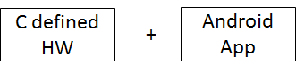

Cloud RTR
Cloud RTR
Static Design
Static Design
Static Design
1
2
3
1
2
3
1
2
3
Manufacturers
Android
Developer
FPGA
ARM
Consumer
Notes:
Here we introduce the architecture of our system to let us create our vision of apps with hardware.
We introduce a “cloud compiler” to the app store- the essential component of Cloud RTR. This cloud compiler will compile hardware modules for apps. This is done in a brute-force manner that I elaborate on later, where each app is compiled for each slot in each static design. Remember- each generated bitstream can only be used for one particular slot in one design.
To perform compilation, the compiler needs to have all the static designs. These are created by the manufacturer and provided to the compiler.
We also need to have operating system support on devices, and these devices obviously need to have an SoC with a CPU and an FPGA.
Finally, we need to have a design flow for developers to create applications and hardware together. We have leveraged high-level synthesis technologies to make this easier.

Slide 39
Manufacturer
Creates a static design
All logic that does not change
Design includes areas reserved for slots
Sends this to the cloud compiler
Static Design
GPU
AXI
1
2
3
Notes:
Manufacturers are tasked with created static designs for their devices that include the needed slots.
A static design is the part of the FPGA that is not changed by a partial reconfiguration. Must include the slot definitions and needed interconnects, such as an AXI bus, but also other needed logic, such as a soft gpu or other processing, such machine learning applications.
The manufacturer then needs to provide this design to the cloud compiler in order for hardware to be compiled to it.

Slide 40
Developer
Create an app using existing tools
Create a hardware definition in C
bool example(ap_uint<32> *in
ap_uint<32> *out,
bool *enabled,
)
Notes:
Developers will create applications using existing tools, such as high-level synthesis, to create hardware for slots. This goes along with an unmodified design flow for developing an application, such as with the Android SDK.
HLS allows for applications to easily implement the required interconnections and then for it to be transformed into a design language, such as Verilog. Recall that slots have to have identical interfaces to the static design- in HLS, this is simply the implementation of a specific function declaration. HLS does not need to be used to do this, but ensuring that this interface is maintained is very simple in HLS.

Slide 41
App Store (Cloud Compiler)
Compiles hardware for each app
For each device variant
For each slot in each variant
App
X
[device1:
[slot1: a.bit,
slot2: b.bit,
slot3: c.bit]]
[device 2:
[slot1: d.bit,
slot2: e.bit]]
Cloud Compiler
Static Design
Static Design
Static Design
1
2
3
1
2
3
1
2
3
Notes:
To provide the cloud compiler, we extend app stores with a compilation service, that compiles uploaded hardware for each slot in each static design.
This produces a bitstream for each slot on each device, for every uploaded app that has hardware, allowing for the hardware to be run in any slot on any device static design.
The store ensures that apps are only provided to devices with bitstreams that have been compiled for the device that download them, as the app store has this global knowledge. This prevents the need to send all generated bitstreams with an app when they are downloaded.

Slide 42
User (Operating System)
A system service manages slots
Downloaded apps include slot hardware
The system service loads app hardware for apps
FPGA
GPU
AXI
1
2
3
X
.apk:
[device 1:
[slot1: a.bit,
slot2: b.bit,
slot3: c.bit]]
Notes:
(Be here by 24:30)
Operating systems also need to be extended in order for them to load hardware for app.
We have implemented a system service that maintains state of running hardware in slots and loads this hardware on request.
As each app will include bitstreams for each slot, the service will select one to run in the best available slot.

Slide 43
Software Defined Secure Hardware
Notes:
Now, we present our second solution, software defined secure hardware, and present some evaluation results.

Slide 44
Fundamental Problem:
Having Secure Hardware that is Reprogrammable
Notes:
Recall that the fundamental problem we are trying to solve here is how to use an FPGA to run secure hardware.

Slide 45
Leverage FPGA Flexibility
Use an FPGA to implement arbitrary secure hardware
Have same security as silicon hardware
Notes:
Our goals are to leverage the reconfigurability of an FPGA to run arbitrary secure hardware functions, and have the same security properties as if they had been implemented in silicon.

Slide 46
Challenge: Reprogrammability
Silicon cannot be changed, security leverages that property
Therefore, it appears FPGAs cannot provide these guarantees
Notes:
However, the problem is that FPGAs are reprogrammable. Silicon cannot be changed, which is why FPGAs exist in the first place.
But this immutability is leveraged by secure hardware, so it would seem that FPGAs cannot implement secure hardware the way we want.

Slide 47
Traditional FPGAs
Dev 1
Traditional use puts a function into an FPGA
AES
FPGA
Notes:
Here, we examine how FPGAs have tried to provide secure hardware in the past.
In traditional usage, an FPGA runs a single application.

Slide 48
Traditional FPGAs
Dev 1
Traditional use puts a function into an FPGA
Functionality can come from any source
AES
FPGA
Notes:
However, there are no restrictions on when a new configuration can be loaded in this model.

Slide 49
Traditional FPGAs
Dev 1
Traditional use puts a function into an FPGA
Functionality can come from any source
There is no distinction between process and functionality trust
DES
FPGA
Attacker
Notes:
This means that an attacker can load a malicious configuration at any time. This means that there is no distinction between the functionality trust, or trust in the implementation of the application, and process trust, or trust in the party that can change how the implementation operates.

Slide 50
FPGAs with IP Protection
Dev 1
Lock FPGA
An improvement is to use IP protection
Load App
IP Protection Hardware
AES
SHA3
RSA
Notes:
A solution to this problem has been to use IP protection. A developer can lock the FPGA to themselves, meaning only they can change the implementation.

Slide 51
FPGAs with IP Protection
Attacker
An improvement is to use IP protection
Fixed secure hardware allows only a single source
IP Protection Hardware
AES
SHA3
RSA
Notes:
This approach generally uses some type fixed secure hardware, which prevents an attacker from directly changing the implementation. This is usually some sort of secure boot primitive.

Slide 52
FPGAs with IP Protection
Dev 1
Lock FPGA
An improvement is to use IP protection
Fixed secure hardware allows only a single source
Process and functionality trust are reduced to a single source, but are now coupled
Attacker
IP Protection Hardware
DES
SHA3
RSA
Notes:
However, if the developer is compromised or become malicious, there is nothing to stop them from loading a malicious configuration. This is because with IP protection, process and functionality trust are still coupled to a single source, but there is no mitigation against this party from being malicious.
We note that secure hardware does not have this problem. Even in secure hardware systems that have process trust relationships, such as secure boot or SGX, the functionality trust cannot be betrayed even if the process trust is.

Slide 53
Process Trust in FPGAs
Traditional FPGAs
FPGAs with
IP Protection
FPGA
FPGA
Notes:
This brings us back to this picture, which summarizes these trust relationships.
Traditional FPGAs trust process and functionality from any source.
IP protections trusts a single source for both.

Slide 54
Introducing Software Defined Secure Hardware
Decouple trust using self-provisioning
Lock functionality to a single authorized application
Allow secure hardware to mediate its own process trust
New applications can be authorized, but only through a fixed protocol
SDSHW
FPGA
Notes:
Here, we introduce software defined secure hardware.
The goal is to decouple trust so that functionality is a one-time trust operation, as in secure hardware.
We also still want to leverage the reconfigurability of the FPGA without compromising the functionality trust, so we also allow for the FPGA to mediate its process trust directly, so it only trusts itself for changes to its operation, rather than relying on an external party to always be trusted.

Slide 55
Software Defined Secure Hardware Platform
SW Applications
Secure HW Application
Custom
Hardware
OS
Secure Storage
Update System
SDSHW
Platform
CPU
FPGA
Fixed
Hardware
Minimal Secure Hardware
Notes:
Our sdshw platform does this by leveraging an amount of fixed secure hardware, such as that is used by IP protection. This is used to lock the FPGA to a single implementation that includes the needed subsystems of our platform. Using a self-provisioning process.
On top of the provisioned system, we require two services that run in the trusted FPGA configuration.
The first is the update system, which allows for updates to be applied under certain conditions.
The second is the secure storage system which is needed for the update system to work.
Finally, arbitrary secure hardware applications can be built on top of this platform by including them in the trusted FPGA configuration. This can all be done alongside other usage of the device, such as an untrusted OS and software that run in other hardware, such as the CPU.

Slide 56


Self-provisioning
Leverage common secure hardware
Used for IP protection
Generate keys inside the device
Break process trust by preventing arbitrary reconfiguration
Lock a single configuration to the FPGA
Provide one-time functionality trust
Secure Boot
Secure Storage
Sign Hardware
Verify Signature
FPGA
Notes:
To lock the FPGA to a single implementation, we use a self-provisioning process, so that we can decoupled the functionality and process trust of the traditional usage of IP protection hardware.
We leverage this minimal hardware, but we generate keys inside the device. These systems are similar to secure boot, but we use it in a different manner. Instead of generating keys outside of the device and trusting them to be securely held using a process trust relationship, we generate them inside the device, and trust the device to maintain the process relationship with itself.
These keys are used to sign a single hardware configuration, which locks the FPGA to this single hardware, and prevent future hardware from being executed.

Slide 57
Secure Updates
Hardware updates allowed, but must prevent abuse
Encode security policy into FPGA application:
Signed by developer
Authorized by user
Signed by developer and authorized by user
No updates allowed
Notes:
We still want to allow updates, but we want to prevent malicious abuse, so that the process trust only involves the FPGA itself. To do this, updates can only be performed by this initial hardware configuration, which requires adherence to a security policy. These are some examples:
…
As these are part of the locked hardware, they are fixed at provision time and cannot be circumvented.

Slide 58
Secure Storage
Fixed hardware enforces self-provisioning using the generated keys
These keys are required to authorize a new update
Ensure that only the FPGA can read these keys
Notes:
(Be here by 32:00)
To allow for updates to be possible, we need to hold onto the generated key on the device. We therefore also provide a secure storage system that only allows the FPGA to access them. The update system in the FPGA can then read these keys can sign a new update, which will then be accepted by the fixed hardware.

Slide 59
Implementation
Using the ZCU102
Using proprietary Xilinx secure boot
Must also use Xilinx tools for updates
Leverage the AES accelerator to provide secure storage
Notes:
We implement a proof-of-concept of our system using the Xilinx ZCU102 development kit. This system uses a proprietary secure boot and boot image format, so we must use Xilinx’s tools for updates and the initial boot image creation.
We also leverage to the embedded AES accelerator to provide a replay-protected storage.

Slide 60
Xilinx Secure Boot
Secure Boot
Secure Storage
Booting with Xilinx requires a formatted boot.bin
BootROM parses and boots from boot.bin
Boot.bin can be signed, but the format is proprietary
Sign Bootloader
Verify Signature
Bootloader
FPGA
Notes:
Xilinx’s secure boot requires a proprietary formatted boot.bin file, which is parsed by the BootROM at power on. This is loaded into the CPU and executed. This boot.bin file can be signed, but the format is proprietary. We therefore need to use Xilinx’s tools during self-provisioning in order to generate the initial file.

Slide 61
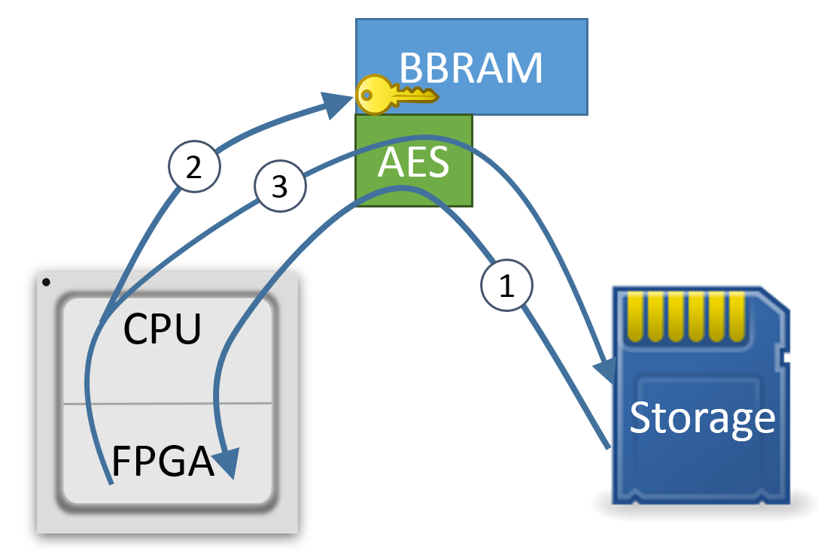
Replay-resistant Storage
Replay-resistance useful for applications
Leverage the AES accelerator
Decrypt storage at boot
Generate a new AES key
Re-encrypt under this key
Notes:
We use the AES accelerator to store the generated secure boot keys. We don’t need replay protection per-say, as the keys never change, but we use the secure storage to support other applications. The AES accelerator uses battery-backed ram to store an encryption key that can only be read by the accelerator. We encrypt under this key and only allow for the data to be decrypted with this hardware. We then roll the key each boot an re-encrypt so that past data cannot be replayed.

Slide 62
Updates using Xilinx Tools
To update, need a new boot.bin
boot.bin can only be generated by Xilinx tools
Therefore, boot into a special update OS when an update is authorized
Notes:
As boot.bin is proprietary, we still need to use the Xilinx tools. Therefore, we actually need to use a special operating system to generate a new file, once authorized by the FPGA.

Slide 63
Example: Secure Filesystem
Secure Boot
Secure Storage
Similar to one of the features of Apple’s Secure Enclave
Requires a PIN entry to unlock storage, with hammering resistance
PIN stored in secure storage
Decryption does not occur unless the PIN is correct
System is locked out after a set attempt threshold
Sign FPGA
Verify Signature
Read Key
AES Encrypter
User PIN
Boot OS
Encrypt Data
Operating System
FUSE Filesystem
Notes:
The first example that we created was a secure filesystem, similar to Apple’s secure enclave. This filesystem stores an encryption key in secure storage along with a user’s PIN and a counter. On startup, this PIN needs to be provided to the hardware before it will decrypt data, with a set number of attempts. This can be used, for example, by a fuse filesystem on the OS side that decrypts data using the hardware

Slide 64
Example: Trusted Execution Environment
Hardware Implementation
SDK
Remote Attestation
Applications
Password Manager
Private set intersection
Notes:
Our second example was a trusted execution environment, similar to SGX. We implemented FPGA hardware to run it and an SDK to generate programs for it, and included a remote attestation system. We then built two applications - a password manager and a private set intersection app.

Slide 65

Hardware Implementation
Remote client
Untrusted ARM CPU
Remote Attestation
Server endpoint
Enclave driver
Enclave libraries
Trusted FPGA Logic
Secure RNG
Enclave
Logic
µBlaze
ECDSA
µBlaze
Enclave
Notes:
(Hardware implementation steps. Read through the animation)

Slide 66

SDK
Enclave library
User created
encl.h
interface.json
encl.c
arm.c
mb.c
SDK / Cross Compiler
ARM binary
µBlaze binary
Notes:
(SDK steps. Read through the animation)

Slide 67
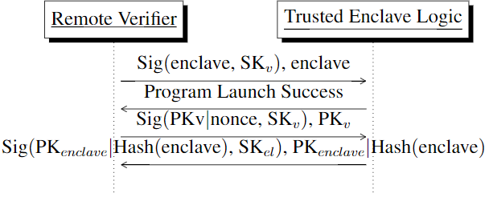
Remote Attestation
The MicroBlaze binary is hashed when loaded
Remote verifier and loading logic exchange public keys
Remote verifier verifies loading logic’s signature and provided hash
Notes:
The remote attestation flow allows for the microblaze binary to be attested by the enclave logic. When a program is loaded into the microblaze enclave, it is hashed. A remote verifier sends their signed public key to the enclave logic, which responds with a signature over the hash of the binary and its own public key, which are sent back to the verifier. We use ED25519 signatures, so the exchange of public keys allows for a shared secret to be established, allowing for the verifier to establish a secure channel with the enclave.

Slide 68
Applications
Password Manager
Encrypt/decrypt user credentials in the enclave
Perform encryption using user password and key stored in secure storage
Only encrypted data stored in persistent storage
Private set intersection
Upload encrypted set values
Decrypt and match against set in the enclave
Negotiate secure channel during remote attestation to return results
Notes:
Our first enclave application is a password manager, which encrypts and decrypts passwords inside the enclave, using a key stored in the enclave and the user’s passphrase. Only encrypted data is stored persistently in external storage.
Our second application is a private set intersection, which matches an uploaded set of integers against a set of integers in the enclave, which are sent using the negotiated secure channel during remote attestation.

Slide 69
Evaluation
Determine the design trade-offs when using an FPGA
Recognize that FPGAs are not always the best target, but performance is not the goal
Notes:
We use these applications to evaluate the tradeoffs of running secure hardware in an FPGA. We recognize that using an FPGA will have some performance impact compared to other implementations, but performance is not the goal of this system.
(if short on time:)
Due to time constraints, I will skip the eval. The secure filesystem app has on average, 1.38% overhead compared to software and execution in the microblaze enclave is about 20x slower than software.

Slide 70
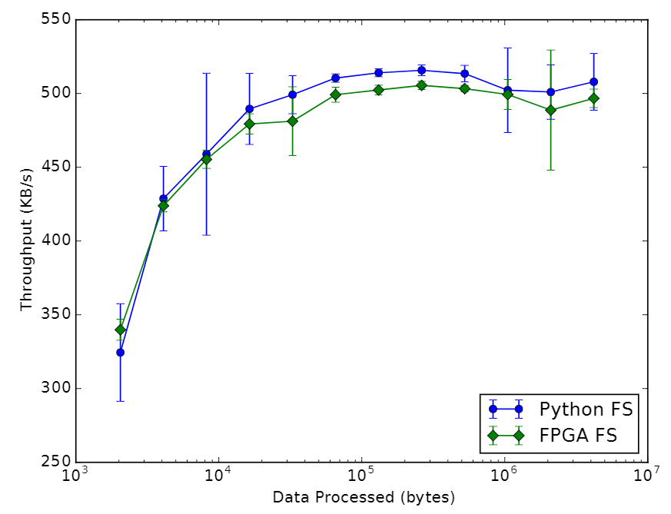
Secure Filesystem Throughput
Notes:
The secure filesystem, when compared to an implementation using a pure Python fuse implementation, has about 1.38% overhead. Files were stored in the FS from 1 KB to 4 MB.

Slide 71
Enclave Execution Benchmarks
Loading an enclave can be done at 35 KB/s
The Microblaze CPU is generally 20x slower than a software implemnation
The password manager can read passwords in 120 ms and write passwords in 202 ms
Notes:
Loading an enclave can be done at 35 KB/s, and executing code in the Microblaze is 20x slower on average than compared to software on the coupled CPU.
The password manager can read a password in 120 ms and write a password in 202 ms. As this is a user-interactive application, is is sufficient for user use.

Slide 72
Remote Attestation Performance
Used the private set intersection application
Matches a set of 17 client integers against 6 enclave integers
107.2 ms average end-to-end latency, 8.604 ms standard deviation
Notes:
(Be here by 42:00)
The private set intersection application is intended to measure the end-to-end latency of the remote attestation system. In laboratory network conditions, there is an average of a 107.2 ms end-to-end latency for uploading the set to the enclave, performing the match, and receiving the result.

Slide 73
User Space Secure Hardware
Notes:
In this section, we present the combination of Cloud RTR and SDSHW to provide our overall goal of user space secure hardware

Slide 74
Combining Solutions
Cloud RTR provides user space hardware in an FPGA
SDSHW provides secure hardware in an FPGA
Combine the contributions to provide User Space Secure Hardware
Notes:
Since Cloud RTR essentially provide user space secure hardware, and SDSHW allows for hardware to be secure in an FPGA, we should be able to run Cloud RTR on top of the SDSHW platform.

Slide 75
Challenges
Cloud RTR and SDSHW are incompatible
Cloud RTR requires complete FPGA control
SDSHW assumes all of the FPGA is trusted
Notes:
However, there are some challenges to this, as Cloud RTR and SDSHW are incompatible.
Cloud RTR requires full reconfiguration control of the FPGA, but this kind of external control is forbidden by SDSHW.
SDSHW trusts all hardware in the FPGA, but Cloud RTR allows for untrusted hardware to be loaded dynamically.

Slide 76
Solutions
Remove direct configuration control from Cloud RTR
Use internal configuration to load modules from the CPU
Remove trust in the entire FPGA from SDSHW
Redesign slots for isolation while still having peripheral access
Notes:
To solve this, we have two main solutions:
The first is to remove direct configuration control from Cloud RTR, and put into the FPGA by using internal reconfiguration.
The second is to remove trust of the Cloud RTR slots from SDSHW by redesigning how they interface with the static design.

Slide 77
Internal Reconfiguration
Secure Storage
Verification Data
Slot 1
Slot 2
(in use)
CPU
1. Load Bitstream
2. Verification
Logic
ICAP Controller
4. Loaded in Slot 1
Loading Logic
3. Reconfigure Slot 1
FPGA
ICAP
Notes:
The internal reconfiguration system is a hardware block in the FPGA configuration that interfaces with the internal configuration access port in the FPGA.
(Internal reconfiguration. Read animation)

Slide 78
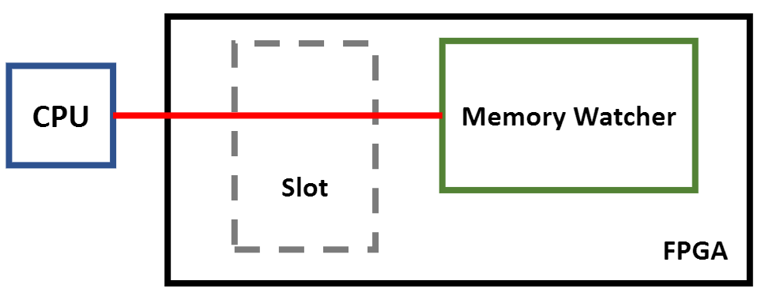
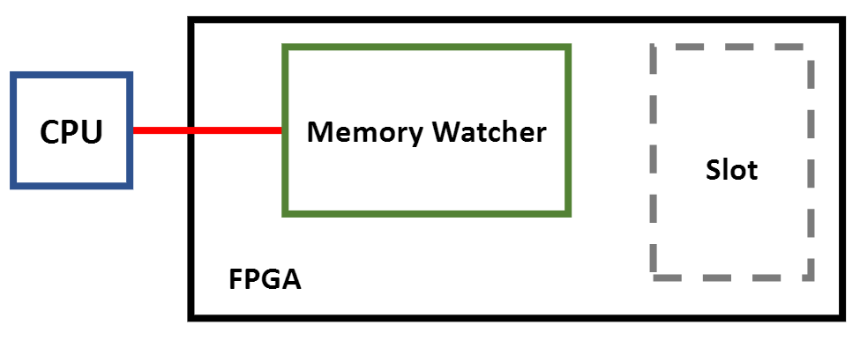
Slot Isolation
Floorplan slots to not interfere with sensitive signals
May need to use constraints if the design is overly complicated
Notes:
(Be here by 45:30)
To remove trust of the slots, we need to ensure that they cannot snoop on data in the FPGA. As Cloud RTR compiles slots so that they include any shared wires with the static design, we want to reduce the number of wires routed through slots that may contain sensitive data. Therefore, we can use floorplanning as a first step to physically isolate the slots from the rest of the static design so this routing is unlikely to occur. We can then use constraints to limit routing further if needed, but must be careful, as this is what made prior research to Cloud RTR impractical. There must be a tradeoff between these routing risks and placement of logic in the FPGA.
We note that snooping on such a wire is theoretical, so we don’t know if this is even a credible risk.

Slide 79
Secure Storage Access
Secure Storage
Storage Proxy
CPU
Loading Logic
Slot 1
Slot 2
FPGA
Notes:
Slots will need to store state in the secure storage, but should not access state for other apps. We have a proxy system that only lets a slot access its own data.
(secure storage. Read animation)

Slide 80







Combined Solution
5. Upload to Distributor
CPU
Cloud RTR
SDSHW
FPGA
CPU
FPGA
FPGA
FPGA
1. Build Chips
2. Assemble Devices
3. Provision Devices
4. Develop Applications
6. Download applications
Notes:
Overall vision, combining Cloud RTR and SDSHW.
(read animation).

Slide 81
Contact Discovery Application
A real-world task that can benefit from user space secure hardware
Match a set of hashed phone numbers against a database of hashes
Notes:
To evaluate the complete vision, we implemented one proof-of-concept application. This is an implementation similar to the contact discovery service implemented in SGX by Signal. It allows a user to upload an encrypted set of hashed phone numbers to be matched against a set of users, so as to not reveal the actual contact list of the user. Using HLS, we implemented a hardware module that can perform this matching and can be reconfigured using Cloud RTR and run on top of SDSHW.

Slide 82
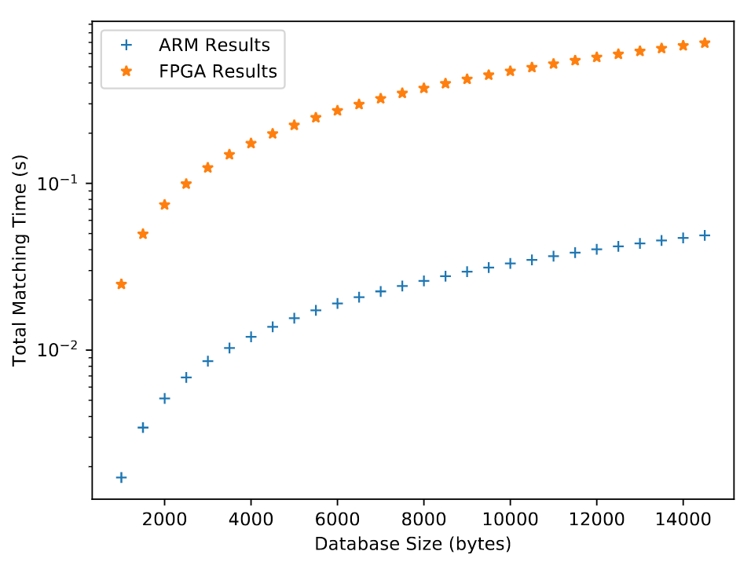
Database Chunk-loaded Implementation
Load database into FPGA one chunk at a time
Perform a set intersection between the chunk and the uploaded contacts
Notes:
Our first attempt loads the database one chunk at a time into the FPGA, and has the FPGA match against the contact list that is stored in FPGA memory. The results show that the FPGA is 30x slower performing this calculation than the coupled CPU.

Slide 83
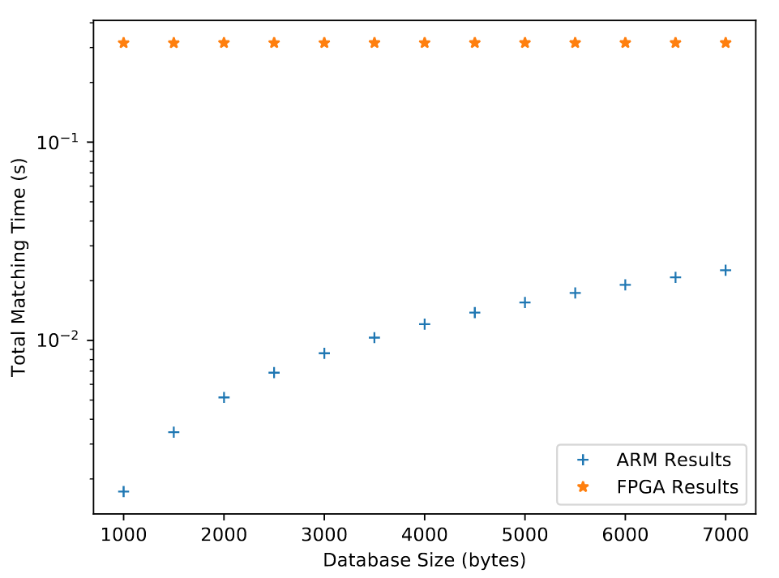
Database Pre-loaded Implementation
Have the database pre-loaded into the FPGA
Limited by available FPGA memory
Notes:
We implemented a second version, where the database is pre-populated into the FPGA, but this was limited by the available FPGA memory. To perform match of a set of contacts against the database was essentially the same in the FPGA, as it leverages hardware parallelism, but performing the same match in software increased linearly with the database size. Eventually, the FPGA would process faster than software, if memory limitations could be overcome.

Slide 84
ICAP Throughput
Measure throughput of loading with the ICAP
Determine how useable the ICAP is
Results: 173.4 KB/s average throughput, with 1.223 KB/s standard deviation
Notes:
(Be here by 48:00)
We also measured the throughput of loading modules using the ICAP. Using both of the previous implementations as reconfigurable hardware modules, we can achieve a throughput of 173.4 KB/s for loading bitstreams.

Slide 85
Future Research
Investigate potential power saving applications
Determine of intra-FPGA attacks (e.g. wire snooping) is practical
Determine the exact trade-offs for slot isolation and routing constraints versus practicality
Notes:
This concludes our presentation of user space secure hardware, but there are a few avenues of research that can be explored.
First, we can investigate potential power saving applications of Cloud RTR in mobile devices, as this was something that we did not explore.
Second, we can determine if intra-FPGA attacks, such as Rowhammer attacks on SRAM cells or wire snooping is possible.
Third, we can determine the exact tradeoffs that are needed for slot isolation and routing against practicality, assuming that wire snooping is a credible threat.

Slide 86
Conclusion
Contributions
Enabled FPGAs to be shared using cloud compilation
Decoupled functional and process trust to enable FPGA secure hardware
Enabled sharing of secure hardware using internal reconfiguration
User Space Secure Hardware combines these solutions
Notes:
In conclusion, the main contributions of this dissertation are:
Enabling FPGAs to be shared between different applications using cloud compilation.
Decoupling functional and process trust in FPGAs to allow for them to run truly secure hardware.
Enabled sharing of secure hardware in an FPGA by using internal reconfiguration.
We combine these solutions to provide user space secure hardware.

Slide 87
Questions?

Slide 88
Future Work
Cloud RTR
Power Savings
Alternate FPGA platforms
SDSHW
Additional feature implementations
Changes to FPGA fixed hardware
Possibility of internal FPGA attacks
Improved HW-SW communication performance

Slide 89
ARM TrustZone
CPU operates in a ‘secure’ mode and a regular mode
Secure mode has access to all peripherals
Regular mode only can access whitelisted peripherals
Communication occurs through specific CPU instructions
Notes:
EK: I’d cut (move to backup)– not sure what the details add to this part of the talk.

Slide 90
Intel SGX
A process creates an encrypted region of memory (an enclave)
CPU only lets the process access this memory
Memory encrypted by the CPU
CPU also provides a system to prove what code is running
SGX remote attestation
Makes use of a burned-in key per CPU and Intel Attestation Services
Notes:
EK: I’d cut (move to backup)– not sure what the details add to this part of the talk.

Slide 91
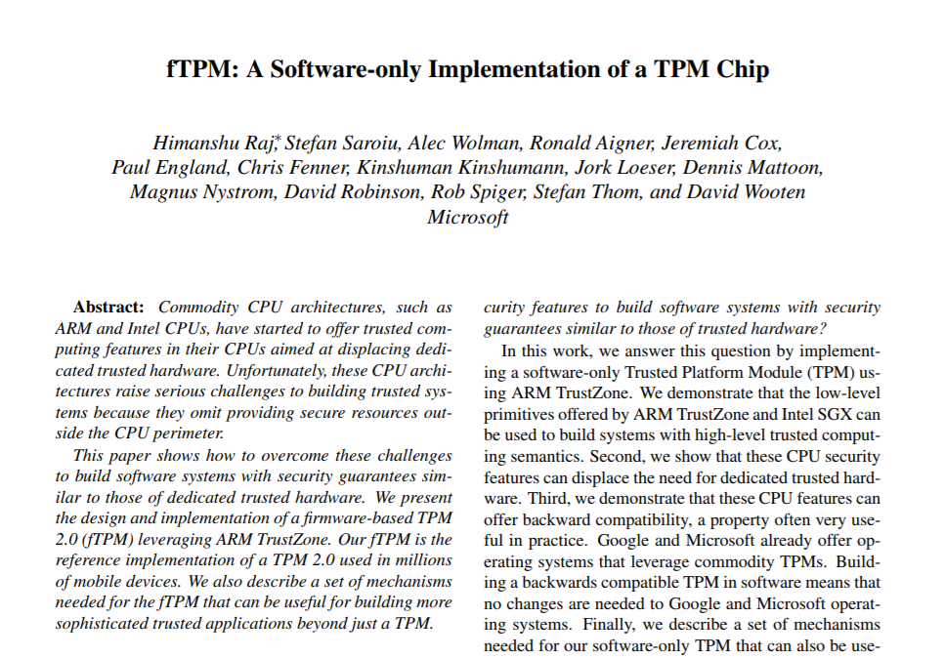
TPMs
Multiple standards (1.2, 2.0)
Many years of design and adoption
Developers forced to implement workarounds
Notes:
-Cannot protect software or prevent unauthorized software

Slide 92
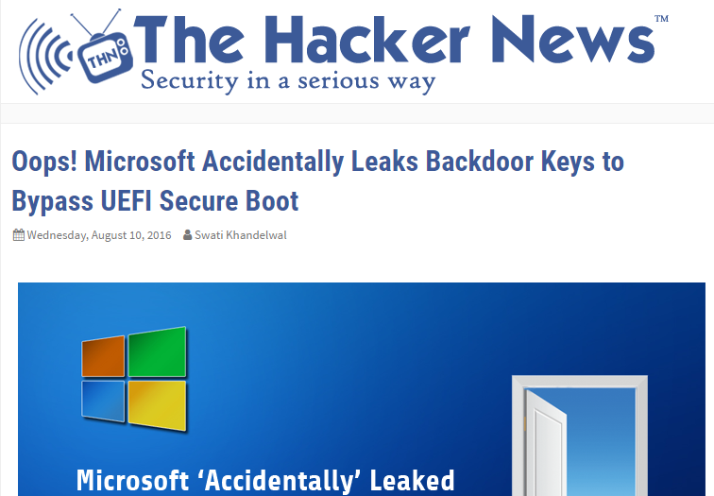
Secure Boot
Susceptible to external compromise
Only protects boot software
Often locks device to a specific vendor
Notes:
Either by leak of symmetric or private keys

Slide 93
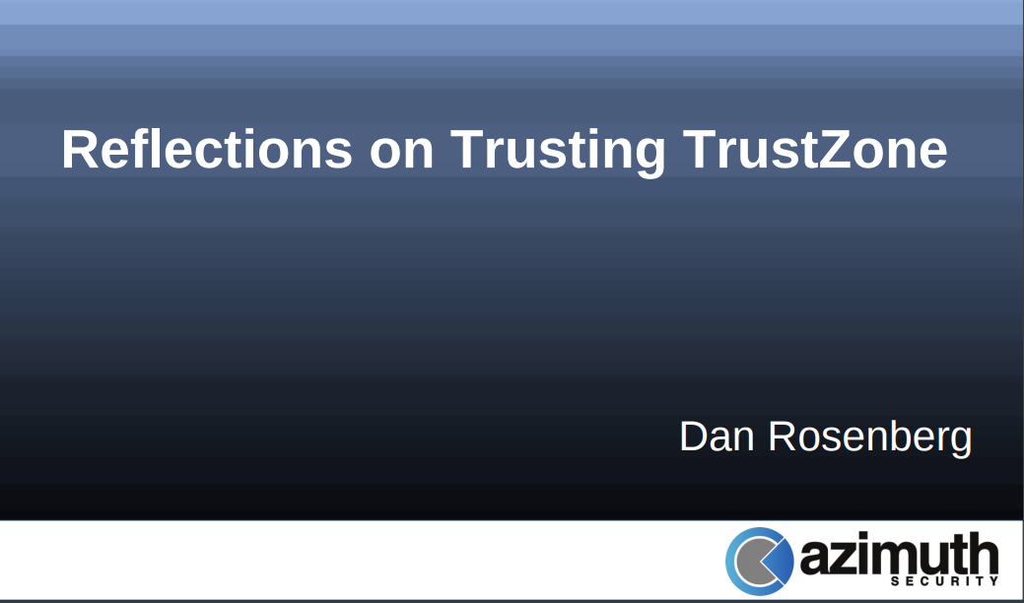
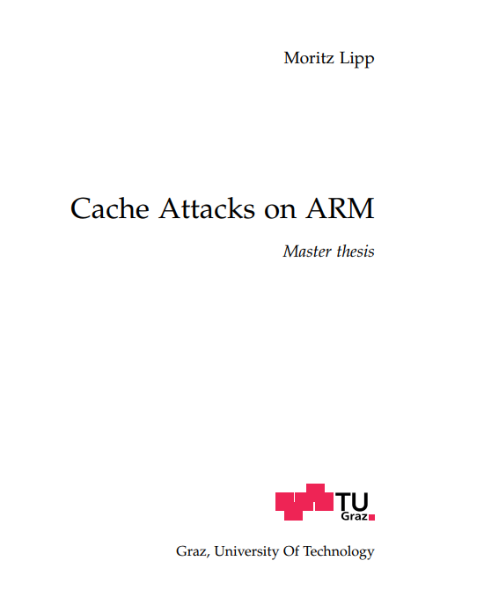
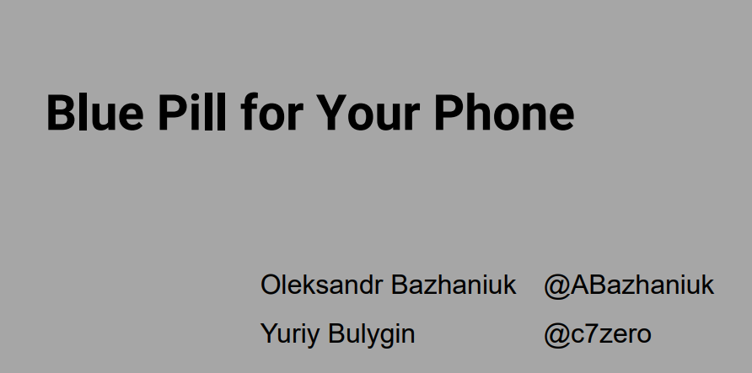
TrustZone
Requires secure boot
Peripherals must support ACLs
Large TCB for secure world OS
Many side-channels in shared peripherals
Notes:
-also, most details about TrustZone are proprietary, so it has been difficult to study directly

Slide 94
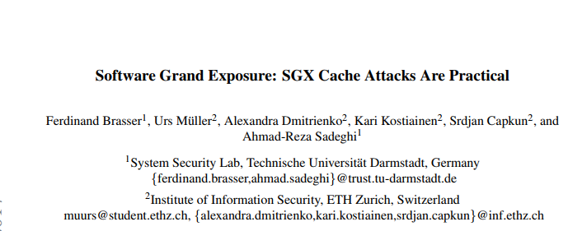
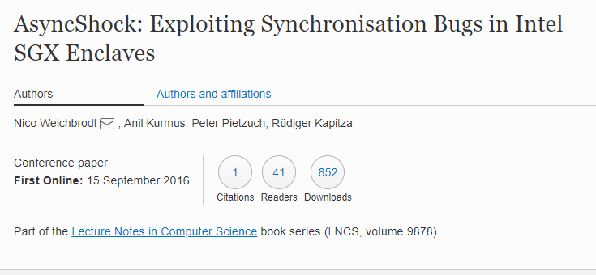
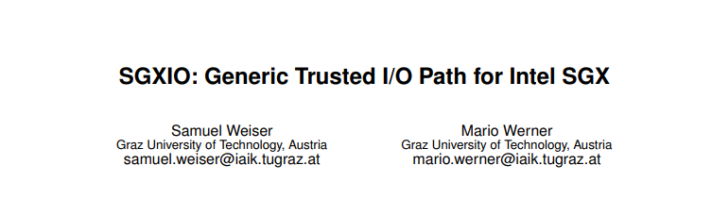

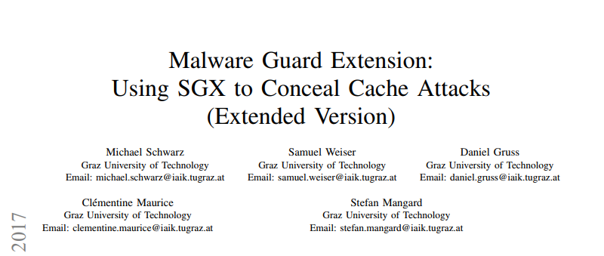
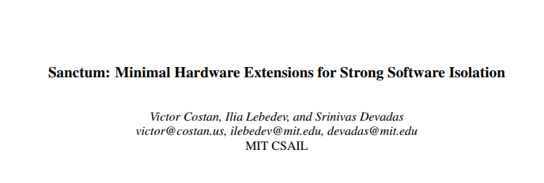
SGX
Many side-channels
Intel Attestation Services
Lack of secure I/O
Notes:
Lack of secure I/O leaves system susceptible to DOS

Slide 95
Trust Relationships
Silicon Manufacturer
(provides secure HW)
Silicon Manufacturer
Hardware Assembler
Hardware Assembler
System Provisioner
System Provisioner
Application Distributor
Application Distributor
Application Developer
(provides secure HW)
Application Developer
End User
End User
Notes:
Hardware security has a trust chain between various roles/parties; each role is trusted to do the thing before it in the chain
However, there are two types of trust we identify: process vs. functionality
Functionality trust is the implementation of some functionality/feature and should only be needed once (one-time)
Process trust is when state is needed to be maintained for the secure hardware to remain secure (not all have this to the same degree, but is a summary)
Developer relies on manufacturer to maintain this so that the application has needed features (SGX) -> manufacturer goes to a platform for features and expects them to be there always
User relies on manufacturer to maintain so that existing applications are secure -> downloads applications that uses a feature, expects the application to be secure (meaning the feature is secure)
Silicon gets functionality trust for free.
In FPGAs, process trust and functionality trust are linked
To get the functionality trust of secure hardware (to get the security properties), need to decouple

Slide 96

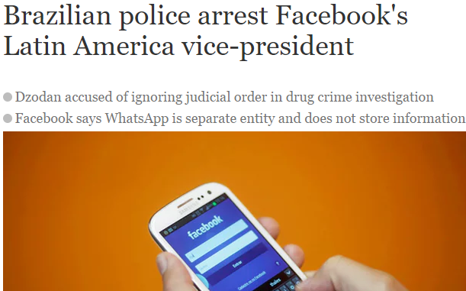
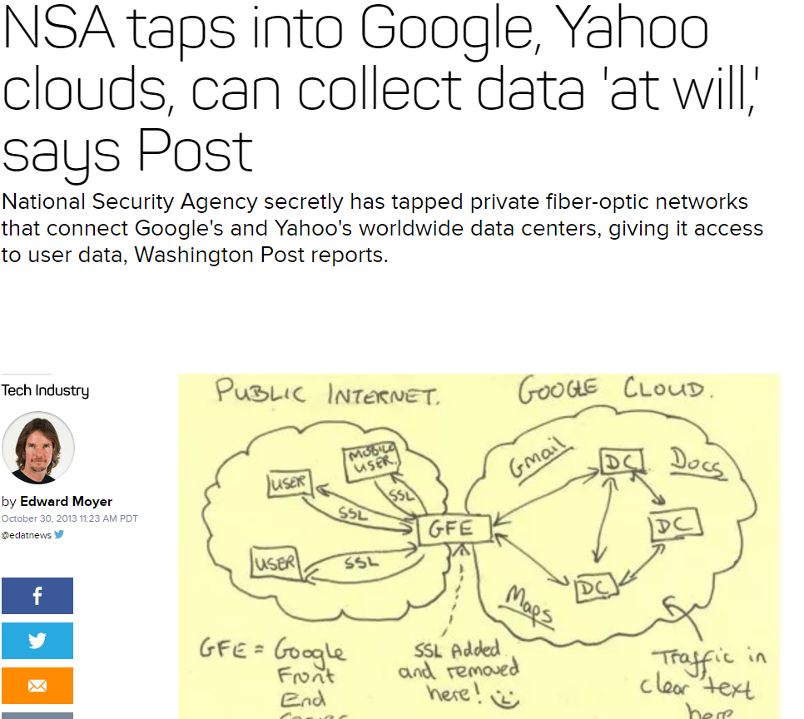
State-level Threats
Physical access is commonly omitted from threat models
However, cloud computing increases this threat
State level actors can also compel access
Notes:
It is assumed usually that physical access can be prevented in most secure systems
With cloud computing though, physical access protection is outsourced. Also, data crosses many different regulatory domains
State-level actors (government agencies, law enforcement) can compel access to systems and gain physical access, despite any protections

Slide 97
Root-of-Trust
Authorizes later boot stages
Implemented in hardware to guarantee authorization occurs
In general, a root-of-trust provides protection against physical access
Secure Boot
Sign Bootloader
Trusted Party
Verify Signature
Bootloader
Operating System
Notes:
Want to talk about a specific technology- the root-of-trust, and specifically, a certain type of root-of-trust-> secure boot
Here, will use the example of secure boot, but other types of trust chains exist that are rooted in hardware. SGX for example
Secure boot
Uses trusted 3rd party for auth
To boot, signs boot material (e.g. bootloader)
When booting bootloader…
Need to check sig
Bootloader can then boot later systems…
Root-of-trust is useful for physical access, as even if software is changed using physical access, it cannot be
Booted unless is signed.
Physical access is a concern when dealing with state-level threats, as physical access can be compelled

Slide 98
Root-of-Trust Examples
Secure Boot
UEFI
Android/Chrome OS
iOS
Intel SGX
Trusted Platform Modules
Notes:
Security functions are moving to hardware to take advantage of this guarantee
Physical access is also becoming a bigger security concern. Both cloud computing and device seizure are problems of physical access, and are how state-level threats can operate

Slide 99
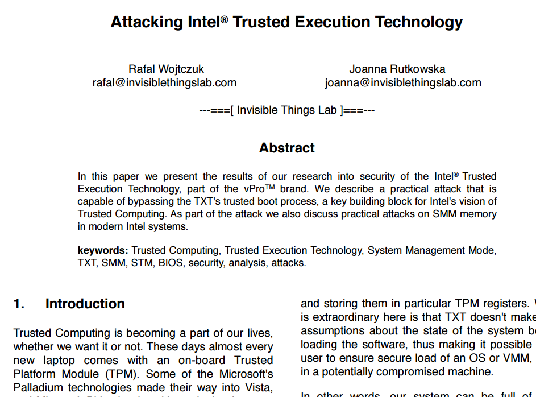
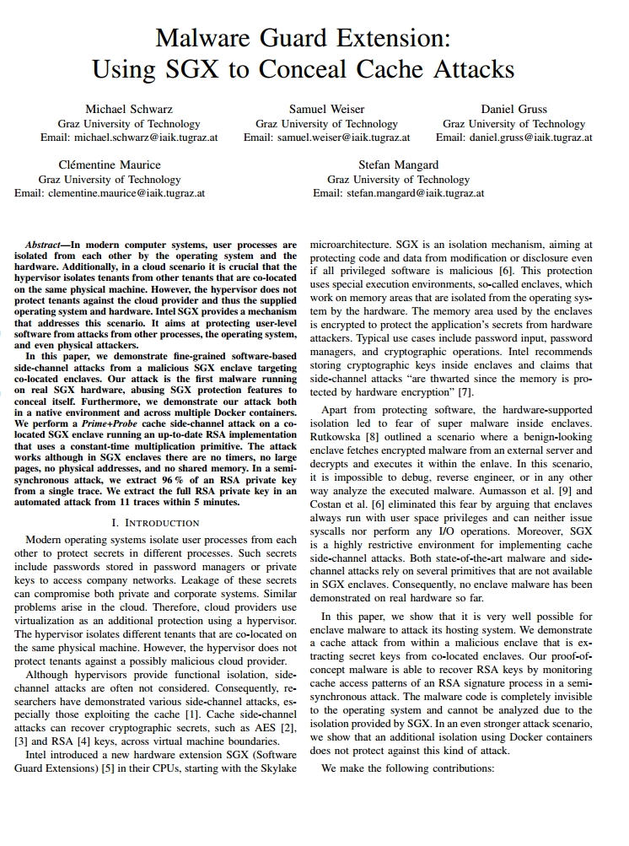
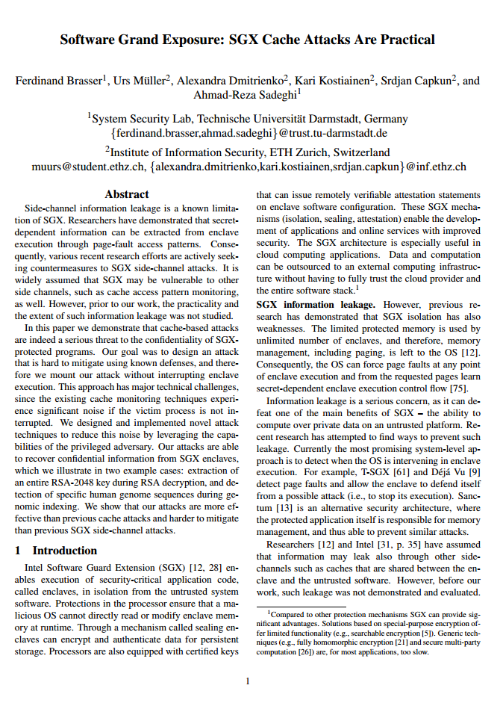
Root-of-Trust Problems - Immutability
Immutability can be a problem
Flaws cannot be updated after manufacture
Notes:
- Hardware is used to combat state-level threats because execution cannot be changed, even with physical access

Slide 100
Problems with Immutability
Hardware design has lead time of several years
Very expensive
Requires anticipation of all use cases and threats
A simple solution is to trust an external party
A root-of-trust then needs to only verify signatures
Notes:
Since all things that need to be authorized are not known at hardware design time, checking a signature makes sense
Trust of an external party removes complexity -> a root-of-trust only needs to verify signatures -> if a signature check passes, then it is assumed that the third party signed off on the software
Works well in theory -> hardware should not have to do any verification of software or have to be interacted with to have software developed -> too complicated and unnesseccary

Slide 101
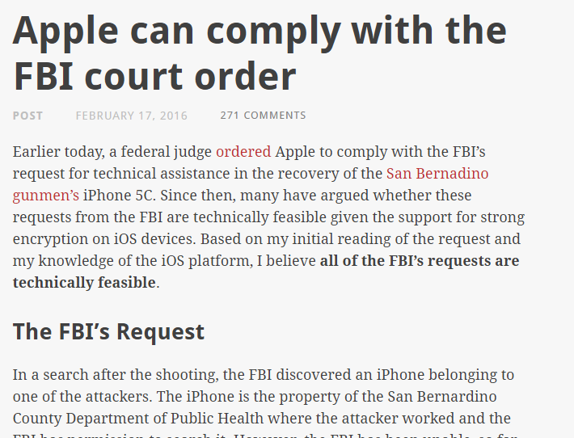
Root-of-Trust Problems – External Trust
Authorization requires external trust
Software must be authorized by someone using a signature
However, the device trusts this signature blindly
Notes:
Hardware system does not know if third party is compromised
Example: UEFI Leak
Example: FBI vs. Secure Enclave
Once compromised, the third party nullifies security provided by hardware
Third parties can be compromised by hacks or insider threats, ignoring the guarantees of the hardware
Third parties can also be coerced by state-level actors, which cannot be prevented

Slide 102
Problems with External Trust
Hackers and insider threats can compromise devices indirectly
State-level actors can directly compel third parties to compromise devices
Notes:
hackers/insider threats can be addressed with better OpSec, but then the security of a device relies on the security of the organization
State level threats cannot be technically defended against in this model. The only defense is to remove the secret entirely

Slide 103
Manufacturer Solutions
Manufacturers could individually redesign systems to remove external trust
Apple could require a PIN for every update
Intel could remove requirement to use SGX API
This does not address updatability
State-level actors can instead attack devices directly
Notes:
- State level actors can also resort to taking the implementation data to find bugs, or compelling that vulnerabilities be designed in (NSA). Not addressing that in this proposal.

Slide 104
Solution: Reprogrammable Hardware
Use FPGA security technology to remove third party
Redesign secure boot process to remove external trust
Use secure boot to prevent changes to configuration
Leverage FPGA reprogrammability to provide updatability
Expose FPGA hardware to OS to improve updatability
Notes:
A root-of-trust without the third party

Slide 105
Challenges
Hardware in FPGA must have same guarantees as silicon to maintain security
Allow for updates to secure hardware without requiring authorization from a trusted third party
Improve design flow to reduce time, cost and invasiveness of designing hardware
Notes:
- A quicker design flow may have more bugs, but is much cheaper and easier to fix bugs. As we know, bugs cannot be eliminated completely anyway

Slide 106
Goals
Create a Root-of-Trust using FPGA security technology
Remove third-party trust
Provide same security as silicon
Expose reprogrammability to improve design process
Make this reprogramability suitable for secure hardware

Slide 107
Outline
FPGA Root-of-Trust
Cloud RTR
Secure Slots for Cloud RTR
Cloud RTR
Secure Slots
TPM
CPU
SGX
FPGA Root-of-Trust
Notes:
These are the implementations of each of these goals

Slide 108
Previous Research
Run-time Place and Route
Is very computationally expensive
Can possibly fail
Slot-base Reconfiguration
Constrained routing is very restrictive and not applicable generally
Therefore, previous research is not practical
Notes:
Both cases, really need to reverse engineer the FPGA.
Rather than fighting the vendors (which is common in the academic community) and assuming they are just
anti-innovation, we take the stance that there are practical
issues with both models -- it not a simple matter of the vendors
choosing to support something. What they support is what is practical.
Cloud RTR makes the existing vendor partial reconfiguration technology work in general using only existing vendor technology

Slide 109
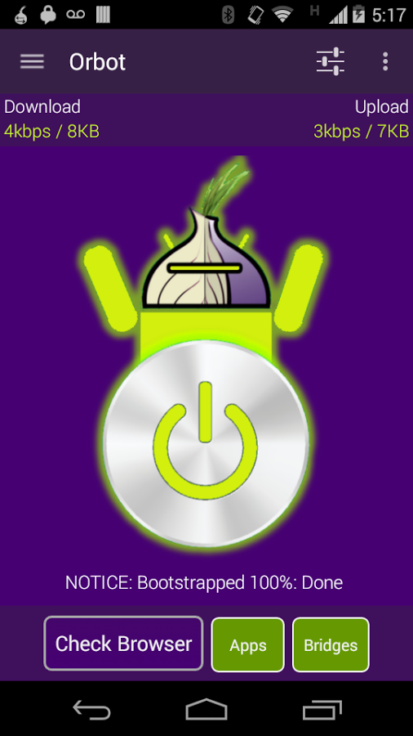
Implementation Case Study: Orbot
Tor on Android
AES is on the critical path
Examine AES as an integration study
Notes:
- Critical path- highlighted specifically by the developers as one of the places to optimize
- We examine orbot as an integration study- i.e. what is needed to be done to port an existing app to use our system for something that might be beneficial to the app.

Slide 110
Implementation Case Study: Orbot
What we found:
Memory operations are the bottleneck
Data must be placed correctly in memory
Userspace I/O has high overhead
Many system calls are incompatible with UIO
It is easier to build an application from ground-up
Notes:
- Data must be placed carefully - in a contiguous region shared with the FPGA (cannot use malloc())
- This must be accessed using memory mapped I/O
- Using userspace I/O (UIO) to do this has high overhead
- Many system calls are incompatible with UIO (memset(), memcpy())
Memory access to shared FPGA memory should be done using a kernel module
This kernel module must allocate memory such that it is compatible with system calls like memset
Building an application from ground up would allows for memory to be allocated in the correct place without having the work around an existing memory scheme

Slide 111
Evaluation
Is there value in apps with hardware?
Is the cloud-based compilation of Cloud RTR practical?
Notes:
There’s general acceptance that hardware (and FPGAs) will be faster than software in a lot of cases. Here, we looking to see if our system imposes an unacceptable overhead and whether our slous compilation system is practical.

Slide 112
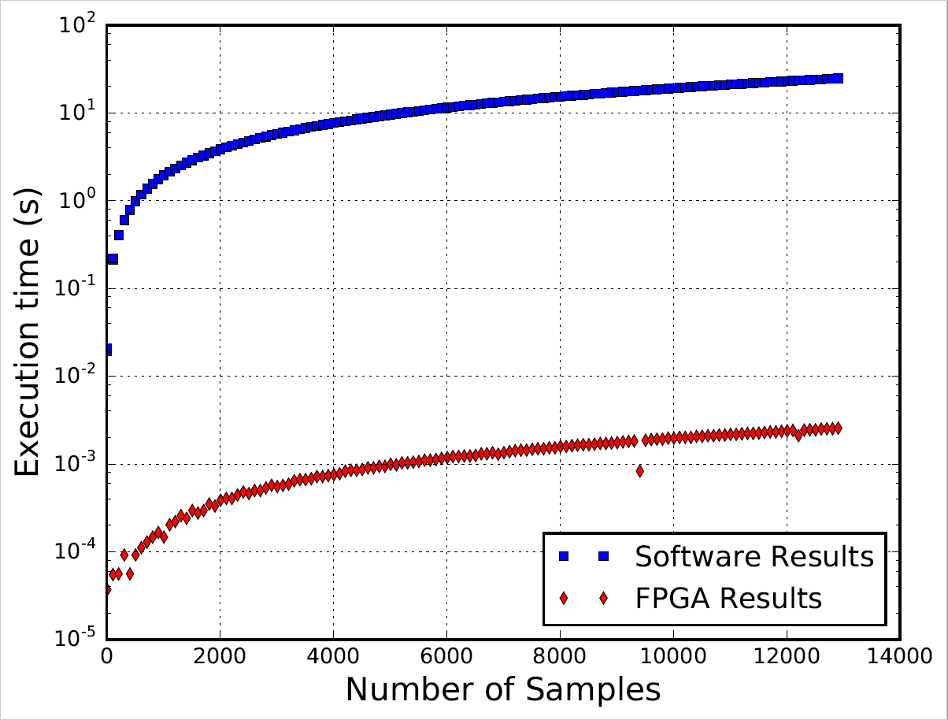
Micro benchmark 1: QAM demodulator
4 orders of magnitude
Notes:
We created a QAM (quadrature amplitude modulation) demodulator as a reconfigurable module that interfaces with an Android app from a Xilinx example application. QAM is used for modulation of various signals, including televisions, and is an example of an SDR application that can be run in the FPGA. We compared it against the provided C++ test bench. It should be noted that this C++ implementation may not be the most optimized for use on a CPU. Also, since we are not reading data directly from a A/D converter, but streaming from memory, the throughput is lower than what is published by Xilinx
4 orders-of-magnitude speedup (e.g. 10,000 times faster)

Slide 113
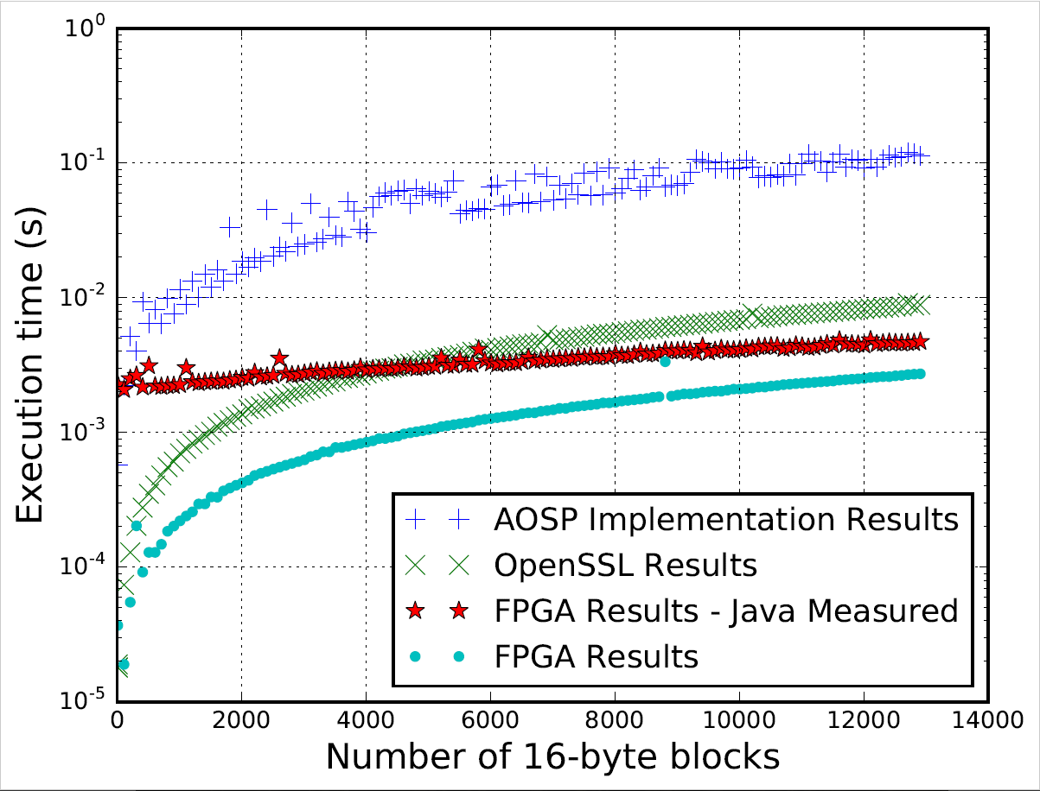
Micro benchmark 2: AES
FPGA is 3x vs. OpenSSL
Notes:
Question: does running in Android cause a performance degradation when accessing hardware? Yes and no. We created an AES encryptor that can encrypt 128-bit contiguous segments of memory (16 bytes) as a reconfigurable module that interfaces with and Android app (red line).
From top to bottom:
(blue) AES performance using the API available in Java for Android apps
(green) Running statically compiled OpenSSL from the Android command line to perform a static sequence of encryptions
(red) Generating data in Java and passing to the FPGA using the JNI using an Android app
(lighter blue/aqua) Running a statically compiled binary to run C code to access the FPGA from the Android command line
When running from inside a Java Android app, the data was generated in Java and passed to the JNI, which then called the app. This shuffling of data has high overhead. When generated directly in C, this overhead is eliminated. Allocating Java direct byte buffers could address this.
IF THERE ARE QUESTIONS:
The difference between the two FPGA results is caused by placing data into memory from Java. Also, for small amounts of data (especially for certain AES modes-of-operation), software outperforms the FPGA due to some state that needs to be preserved between contiguous 16-byte blocks (if the data to encrypt does not fill one of these blocks). There is also a lot of overhead in reading/writing to memory in such a manner that the FPGA can access it

Slide 114
Micro benchmark 3: Memory Scanner
We also implemented a hardware memory scanner
It can scan the entire address space transparently to the OS
2.7% memory read performance hit
5.5% memory write performance hit
We tested this using the LMbench testbench
Notes:
A scanner that can scan the entire system address space without the OS/kernel being involved or even being aware this is occurring.
The only side effect are a slight decrease in memory access performance – 2.7% degradation of reads and 5.5% degradation of writes

Slide 115
Brute-force compilation
Google Play Store Figures
# of Apps as of Dec 14 | 1.43 Million
Average Monthly App Growth | 6.10%
# of Apps for January 16 | 117,521
provided by AppFigures.
Notes:
We extrapolated data from 2014 to the time of writing to estimate the number of apps uploaded per month. With this, we will estimate how many resources are needed to implement our system

Slide 116
Brute-force compilation
Max # of Apps Compiled per day
# of Slots | Apps
2 | 121
3 | 96
4 | 76
5 | 59
6 | 51
2 Slots Requirements | % of April Apps that use Hardware (# of Apps Uploaded per Day)
 | 0.1 (5) | 1 (50) | 10 (500)
# of Device Variants | # of Machines Required to Compile Apps
1 | 1 | 1 | 5
10 | 1 | 5 | 42
100 | 5 | 42 | 414
1000 | 42 | 414 | 4133
Reasonable for most scenarios
Notes:
Left table: how many apps we can compile per day for a certain number of slots using our test hardware. (intel x86 @ 2.1 GHz, 48 GB ram)
Right table: how many servers needed to meet a certain number of uploaded app per month (blue) – 0.1%, 1% and 10% of all uploaded apps - and possible device variants (red)
For reasonable expectations, the resource requirements are not prohibitive when compiling for only 2 slots per device
Note that the bottom-right values (unhighlighted) represents a worst case for this scenario – having 1000 device variants and 10% of apps per day requiring new compilations is unrealistic.
Will discuss why later on.

Slide 117
Brute-force compilation
Max # of Apps Compiled per day
# of Slots | Apps
2 | 121
3 | 96
4 | 76
5 | 59
6 | 51
6 Slots Requirements | % of April Apps that use Hardware (# of Apps Uploaded per Day)
 | 0.1 (5) | 1 (50) | 10 (500)
# of Device Variants | # of Machines Required to Compile Apps
1 | 1 | 1 | 10
10 | 1 | 10 | 99
100 | 10 | 88 | 981
1000 | 99 | 981 | 9804
Still reasonable for most scenarios
Notes:
Same thing, but instead of having 2 slots, we have 6 slots.
69 servers is starting to push the boundaries, but is not an order-of-magnitude more that 29.
Again, the bottom right is a worst case scenario.

Slide 118
Reducing the numbers even more
Compilation can be offloaded to manufacturers
Manufacturers will likely reuse designs (Qualcomm, ARM chips are often reused)
Developers will likely use libraries
Notes:
If the resource requirement is too high (such as in the worst case), a different architecture could offload the compilation to device manufacturers
However, we think that there is little reason to not reuse a design if the chip is the same.
(e.g., just as they buy an SoC from Qualcomm, etc. today)
Finally, we expect that most developers will reuse libraries, for which re-compilation will not necessary.
Examples of libraries:
Crypto blocks (especially things like assymetric crypto, or if someone needed a different block cipher than AES for some reason, or even a highly parrelized version of AES or multiple encryptions)
Graphics acceleration – perhaps have a separate GPU system
Soft processors
Encoding (of images or videos)
Dsp stuff

Slide 119
Vendor Supported Partial Reconfiguration
Goal: Space saving for customer
Static Design
Target FPGA
Vendor tools
base.bit
partial_1.bit
partial_2.bit
(Partial bitstreams work in 1 location,
and are just for base.bit)
Dynamic Module (s)
Notes:
Adopts some from the years of research
Vendor’s goals – save space for customers – partial reconfiguration allows for customers to use one design that has modular/replaceable parts, but these need to be known at design time
Vendor tools -> such as Xilinx Vivado or Altera Quartus
The target FPGA device
“Static design” -> any logic in the FPGA that does not change. Can be anything (such as normal logic, each static accelerators or things like a frame buffer module), but will include necessary interconnects and other modules needed to support reconfiguration, as well as reserved areas for reconfiguration
“Dynamic modules” -> any part of the FPGA that needs to be reconfigured
Will output a configuration ( static bitstream) for the FPGA with reserved regions (base.bit), and “partial bitstreams” that can be used to program only the reserved portions in the static bitstream (these also require that the partial bitstream be programmed into the FPGA)

Slide 120
Examples of Libraries
Crypto
Asymmetric (RSA, ECDSA, etc…)
Symmetric (3DES, Twofish, Blowfish)
Soft processors
Encoding
Network encoding (Reed-Solmon, etc…)
Media encoding (JPEG, MPEG, etc…)
DSP
FFTs, Filters, etc…
Notes:
Symmetric that are not commonly implemented in the CPU

Slide 121
Example hardware definition
bool example(ap_uint<32> *in
ap_uint<32> *out,
bool *enabled,
)
Notes:
ap_uint<N> is HLS to create a 32 bit unsigned input (e.g. an unsigned 32-bit int in C, but can be of any length up to 1024 bits)
Pointer are used for passing arrays (like normal), as well as for modeling outputs and input ports where the signal can change

Slide 122
More complicated hardware definition
typedef ap_uint<32> uint32_t_hw;
typedef hls::stream<uint32_t_hw> mem_stream32;
bool aes(volatile unsigned int m_mm2s_ctl [500],
volatile unsigned int m_s2mm_ctl[500],
volatile unsigned sourceAddress,
ap_uint<128> *key_in,
ap_uint<128> *iv,
volatile unsigned destinationAddress,
unsigned int numBytes,
int mode,
mem_stream32& s_in,
mem_stream32& s_out
)

Slide 123
The problem
Let’s examine the problem
Processor
FPGA
AppX
software
AppX
hardware
I/O
I/O
Notes:
This is from a high level

Slide 124
The problem
First, there are various interconnects needed
Processor
FPGA
AppX
software
AppX
hardware
I/O
I/O
Notes:
2. But in order to get signals to the hardware from the cpu, there are interconnects and signal converters, even for the most simple interface, including things like A/D and D/A converters for exterior (I/O) connections

Slide 125
The problem
Control signals and logic must also be placed
Processor
FPGA
AppX
software
AppX
hardware
I/O
I/O
Notes:
3. In addition, there are control signals that need to be wired to all of these things, and these also need to go back to the processor or some control logic in the FPGA
4. Control signals are also need just to use the app hardware, and to support run-time reconfiguration

Slide 126
The problem
The app may have complex inputs, or need to interact with other logic
Processor
FPGA
AppX
software
AppX
hardware
I/O
I/O
Notes:
5. Finally, if the app needs to interact with other fgpa hardware
6. Or has multiple inputs
This involves to problems in tow problems in hardware design – placement and routing. Placement is simple – put things where there is space in the FPGA and optimize so that interacting logic is close to other logic.
Routing is harder – it is one of the classic NP-complete problems. Also, wires cannot be too long because of PROPAGATION DELAY
Because of this problem, we cannot just put ANY hardware that fits into the FPGA- there might not be space (obvious), and if the wiring needs to match what is already there, so anything that wants to be placed there needs to be known. This is especially important if wires need to be routed through the physical space where the appx hardware goes (red wire), which is fairly common.

Slide 127
Secure loading system
A trusted system is booted with Secure Boot
Included is a static module that reconfigures slots
This module only allows signed modules into slots that access sensitive resources
Notes:
The static design that is booted is also configured to not allow the processor to reconfigure the FPGA -> the static design cannot be overwritten by the OS to bypass the secure loader

Slide 128
Our solution
Builds off of prior research…
…but in a way that is compatible with vendor tools
To do this, we leverage the deployment model for mobile apps
Notes:
We adopt the ides of slots from previous research
Because slots are similar to vendor solution. We use the vendor tools to make slots workable as a general RTR solution
However, we cannot directly do this, or the prior research would have been successful. We need to leverage a property of mobile devices that makes this different from other scenarios, which is how mobile apps are distributed

Slide 129
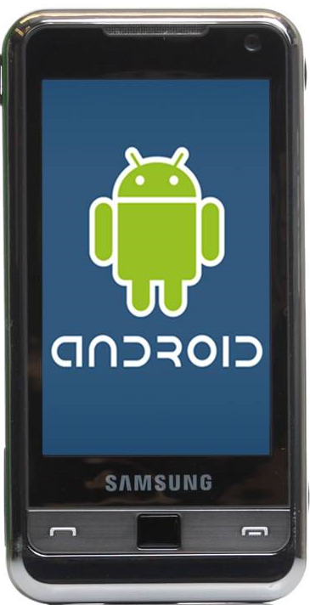
Mobile Devices
Devices are designed around certain restrictions
This leads vendors to make tradeoffs
What if users and developers could choose?
Notes:
Restrictions such as:
- Energy consumption
Form factor
Tradeoffs such as:
- Smaller power sources
- Less powerful hardware
And generally Static capabilities
The question we ask is….

Slide 130
Vision: Smart Phone with an FPGA
App
HW
SW
Android
FPGA
ARM
Notes:
- Our vision consists of a mobile device that includes an FPGA on the same chips as the CPU. With this, applications can include a hardware module that is run inside of the FPGA that is designed by the app developers

Slide 131
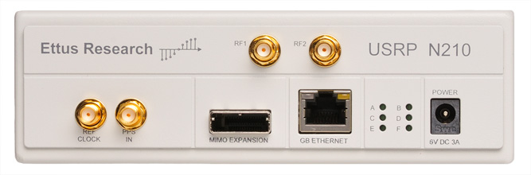
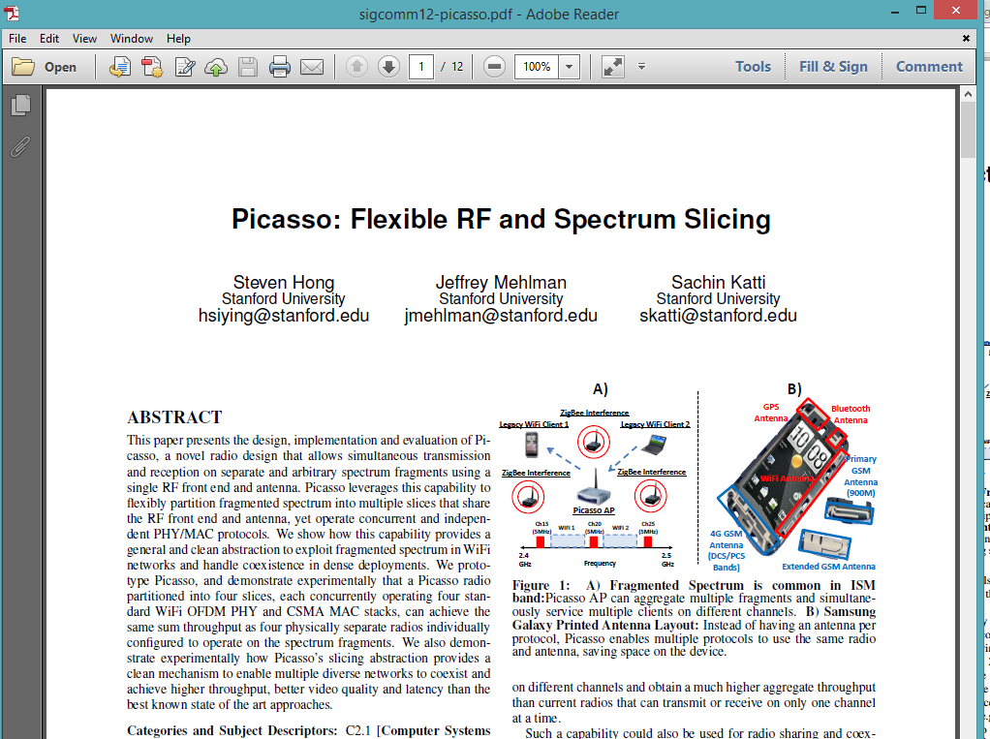
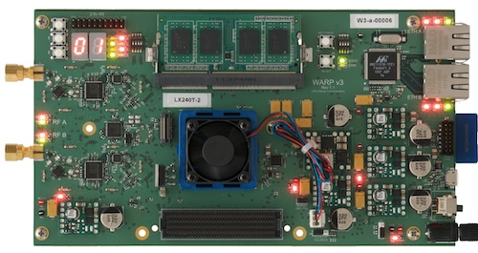
Software-defined Radio
Notes:
For example, wireless protocols that have been proposed by research, but cannot be deployed without specialized hardware
Things that allow for better use of spectrum (the pictured paper), or, for example, UHF retasking (such as WhiteFi), can be done using an FPGA connected to a general purpose antenna

Slide 132
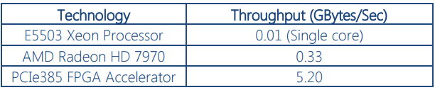
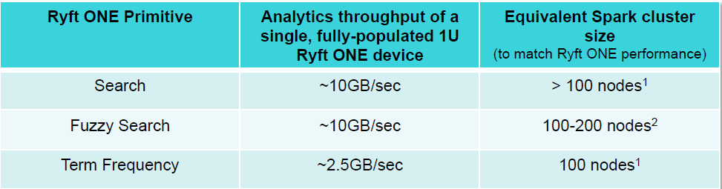
High-performance Computing
Cryptography
http://www.nallatech.com/40gbit-aes-encryption-using-opencl-and-fpgas/
Analytics
http://www.datanami.com/2015/03/10/fpga-system-smokes-spark-on-streaming-analytics/
Notes:
http://www.nallatech.com/40gbit-aes-encryption-using-opencl-and-fpgas/
FPGAs excel at parallel processing, and this has been applied to a number of different applications, including cryptography and analytics, achieving a significant performance gain in both cases.

Slide 133
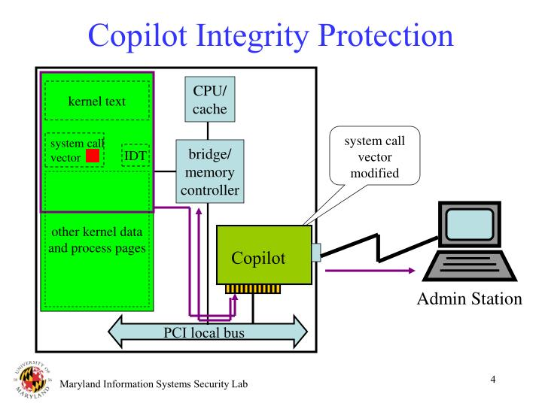


Architectural Enhancements
(SEC 04)
Somniloquy (NSDI 09)
Notes:
Finally, a FPGA can do things that cannot be done in other systems. For example, the copilot project was an attempt to perform rootkit detection using an external pci peripheral that has dma access. This can be done by an FPGA, as it has similar capabilities as a pci peripheral. In addition, computation can be offloaded to the FPGA for a number of reasons - the Somniloquy work offfloads network computation in order to put the CPU into a lower power state.

Slide 134
Why is now the right time?
SoCs with Programmable Logic coupled with ARM Cortex A9 (same as iPhone 4 and many other smartphones)
High-level Synthesis
Write C / C++ / SystemC / OpenCL code
Notes:
We can do this now because SoCs with FPGAs and CPUs on the same chip now exist.
In addition, it is easier to create hardware modules, as they can be defined in a language higher than Verilog using High-level synthesis.

Slide 135
FPGA Root-of-Trust
Secure Boot
Secure Storage
Authorization uses internal keys
All configurations must be signed by these keys
Therefore, device pre-authorizes all boot software
Sign Bootloader
Verify Signature
Bootloader
Operating System
Notes:
-to do this, we leverage the existing FPGA secure boot technology, but store the private key on the device

Slide 136
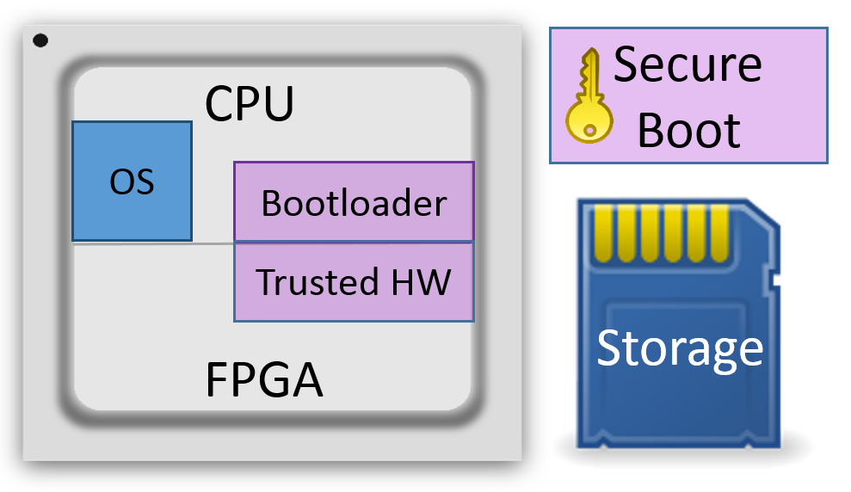
Trusted Hardware
We can now provide trusted hardware
This hardware has same guarantees as silicon
It is also immune to third-party compromise
Notes:
As all hardware is booted in the FPGA configuration, and the configuration is authorized by secure boot, the configuration cannot be replaced without authorization. Therefore, it has the same execution guarantee as immutable silicon hardware
As the key is internal, we remove the third party. Since we need the key to be internal to prevent external changes to provide the same guarantee as silicon, this also provides our defense against third party compromise

Slide 137
Comparison to Secure Boot
All keys are generated and stored on device
Secure boot only stores public key
To boot, software must be signed by this key
In secure boot, signing occurs outside device
This removes the trusted third party

Slide 138
Authorization of Updates
Without the third party, updates cannot be directly applied
Instead, devices will have an update policy in the FPGA
For example, only allow an update after entering a PIN
Notes:
The FPGA configuration cannot be changed externally without device authorization by re-signing
Therefore, we provide the same security guarantees as hardware systems, which also cannot be changed externally
To leverage the reprogrammability of the FPGA, updates can be applied under certain circumstances
An update policy is encoded in the FPGA configuration
Updates can only be applied if they are signed by the device-local key, so only the device can authorize and apply updates
Configuration can include an update policy that is device and/or implementation specific
For example, only allow updates after a PIN has been entered

Slide 139
Provisioning
A device’s secure boot system is initialed un-provisioned
A key-pair must be generated and programmed
Public key programmed to secure boot
Private key stored securely
This should occur at a trusted facility
Notes:
An initial key-pair needs to be generated in a trusted facility
The public key must be programmed to the secure boot system
The operational FPGA configuration must be signed by this key
A trusted facility is required, as the system will boot any configuration before the secure boot system is configured

Slide 140
Challenge: Secure Storage
Need to store authorization key pair
This key should not be accessible outside of device
Also would like to store state
Notes:
FPGAs do not provide any non-volatile storage currently -> could store on sd card
But, we need to make sure the key cannot be exported, or accessed by untrusted hardware/software
Also, to enable applications on top of the root-of-trust, we would like to store some state

Slide 141
Solution: Replay-resistant Storage
Decrypt data from persistent storage
Roll encryption key
Re-encrypt storage under new key
Notes:
FPGAs do not provide non-volatile storage
Such a storage must also only be accessible to the FPGA
We leverage the encryption engine of our device, which has secure storage using the BBRAM
We encrypt a larger storage that is placed on the SD card by the CPU
We generate a new key at each device power-on and re-encrypt to provide replay protection

Slide 142
Prototype
Secure Boot
Secure Storage
Trusted AES encryptor, on top of FPGA root-of-trust
Uses a key stored in hardware
Encrypted FUSE filesystem
Encryption performed in hardware
A PIN must be entered to unlock key
Sign FPGA
Verify Signature
Read Key
AES Encryptor
User PIN
Boot OS
Encrypt Data
Operating System
FUSE Filesystem

Slide 143
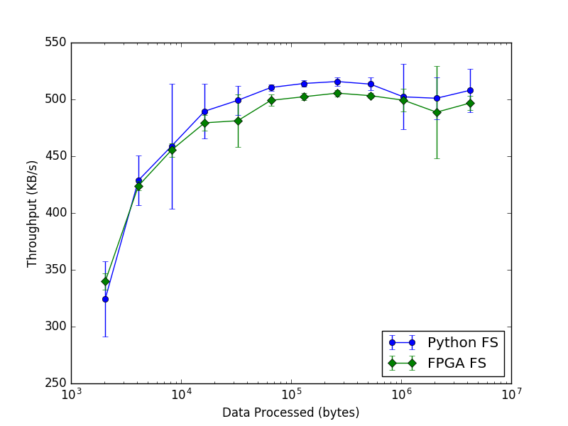
Evaluation
Notes:
Goal was to show that using the trusted hardware was going to impact useability
Tested write performance of the FUSE filesystem by writing files of increasing size
At low file size, FUSE overhead dominates
This is the most naïve implementation

Slide 144
Secure Slots

Slide 145
Securing Slots with Root-of-Trust
We now can provide hardware as part of an application
How to then provide secure hardware?
Secure hardware has access to sensitive resources
Design Root-of-Trust to provide secure slots
Notes:
Note: this still is to be implemented
Sensitive resources: system memory, network or disk
- Enforces access control to hardware using OS mechanisms
In Android/Linux, the slots are presented as character devices in /dev. We use Linux permissions to only allow only the application that has hardware running in a slot to have access to the corresponding /dev devices. This can be done since each app in Android has its own UID.
The slot manager enforces access to hardware
However, FPGAs can theoretically directly access sensitive resources (while bypassing the OS)
A secure loading system ensures that apps cannot access sensitive resources

Slide 146
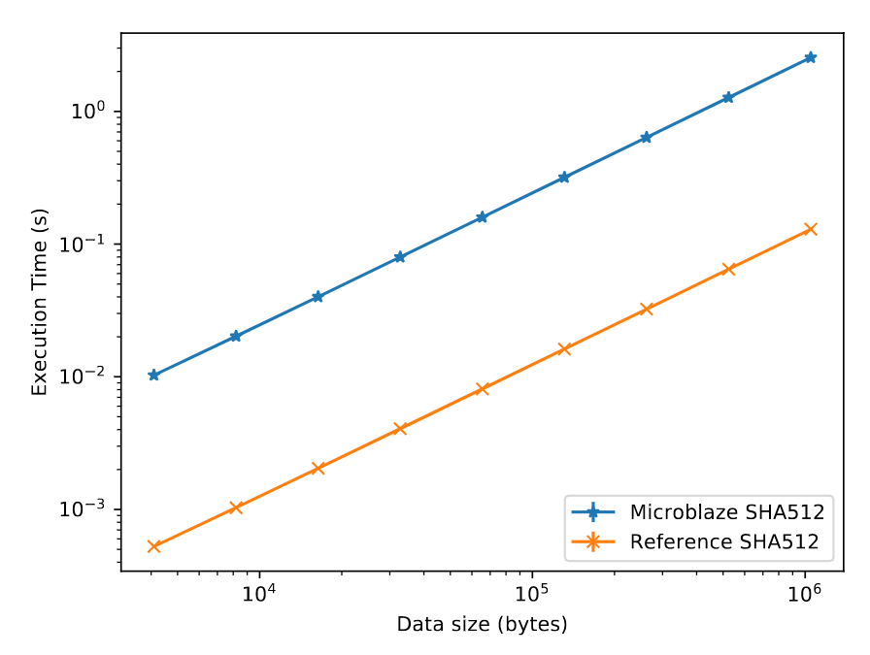
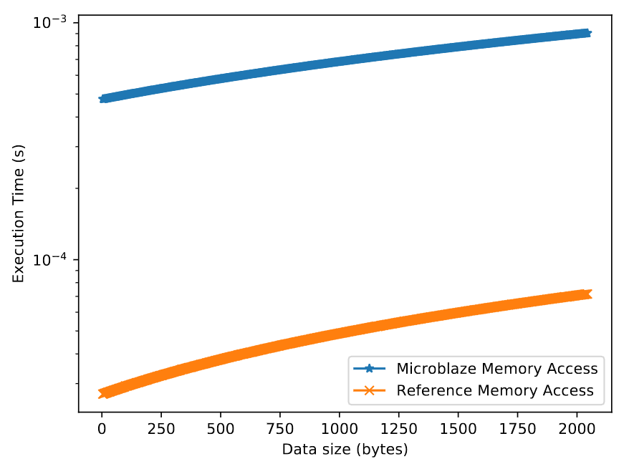
Enclave Execution Microbenchmarks
SHA512 Performance
Memory Access Performance
Notes:
SHA512: MicroBlaze 20x slower
Memory access: MicroBlaze 100x to 12x slower, depending on data size

Slide 147
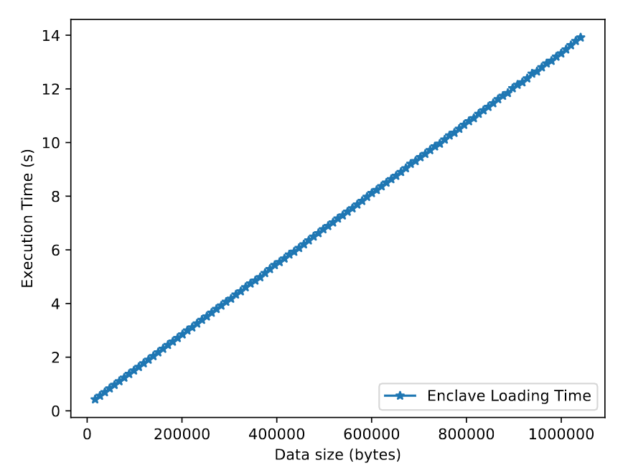
Enclave Loading Throughput
Notes:
- Generated enclave programs of various size, from 20KB to 1 MB
- Average throughput is 35 KB/s

Slide 148


Password Manager Performance
Password Read Performance
Password Write Performance
Notes:
Write throughput likely the same due to storage I/O- needing to write the full encrypted data again masks any latency difference between the implementations
Goal was to determine impact on an interactive application

Slide 149
Slot Preemption
Maintain Cloud RTR’s time-slicing
Need to ensure slots have enough time to save state
Provide a preemption start signal
Allow slot to save state
Have a finished signal

Slide 150
Root-of-Trust with Secure Slots
Memory Controller
Secure Slot 1
Secure Slot 2
Processor
Slot 1
Slot 2
Operating System
FPGA Root-of-Trust

Slide 151
Loading Secure Slot Hardware
Static design is booted using the Root-of-Trust
Design inherits the root-of-trust protections
A secure loader is part of this design
Loader cannot be bypassed without a root-of-trust update
Loader will only load hardware if it is correctly signed
Notes:
Other policies for loading secure hardware can be included, and the public keys that are trusted do not have to be static, and could be user-programmable

Slide 152
Secure loading system
How does the secure loader work?
FPGA
Memory Controller
Slot 1
Slot 2
ICAP
Processor
Operating System
Signature Verification
Reconfiguration Module
Notes:
Let’s say that we have a system that looks like this - a processor and FPGA.
What we also have on any real system are other on-chip peripherals, including a memory controller
There will also be an OS running on the processor subsystem (e.g. Android)
There will also be interconnects from the FPGA to other parts of the chip
And our static design has some slots in it
And then our secure loading system, that will consist of two parts - a signature verification module and a reconfiguration module
Finally, FPGAs also have a system to reconfigure themselves (including partial reconfigs for the slots). This is called the ICAP – Internal Configuration Access Port, and is used by the reconfiguration moduel to reconfigure the FPGA
This configuration is loaded by secure boot, so is guaranteed to be there – a kernel and bitstream must be signed in order for the system to boot

Slide 153
Secure loading system
The OS wants to reconfigure Slot 1
FPGA
Memory Controller
Slot 1
Slot 2
ICAP
Processor
Operating System
Signature Verification
Reconfiguration Module
Signed module
Notes:
Lets say that only slot one has access to memory, so we want to protect access to this slot. We can enforce this in the OS, but if malware bypasses the OS, we still want to enforce this in hardware.
The OS cannot directly reconfigure the slots, as it has not way to access the ICAP (the PCAP, or processor configuration access port, that the processor normally uses to do a reconfiguration, is disabled in this statics design. Therefore, the OS cannot use it to do ANY reprogramming of the FPGA)
To reconfigure a slot 1, the OS sends a signed bitstream to the signature verification system. (if it is not meant for slot 1, then it does not need to be signed)

Slide 154
Secure loading system
The signature of the module is verified
FPGA
Memory Controller
Slot 1
Slot 2
ICAP
Processor
Operating System
Signature Verification
Reconfiguration Module
Signed module
Notes:
If verification passes, the bitstream is passed to the reconfiguration module

Slide 155
Secure loading system
The module is written to the ICAP
FPGA
Memory Controller
Slot 1
Slot 2
ICAP
Processor
Signed module
Operating System
Signature Verification
Reconfiguration Module
Notes:
The reconfiguration module interfaces with the ICAP and write the file to the FPGA

Slide 156
Secure loading system
The ICAP performs the reconfiguration
FPGA
Memory Controller
Slot 1
Slot 2
Signed module
ICAP
Processor
Operating System
Signature Verification
Reconfiguration Module
Notes:
The bitstream lands in slot 1.
This can only happened because it passed the signature verification step at the beginning

